Slide 1
Peer Pressure
&
Refusal Skills

Slide 2
You have heard about the dangers and negative health effects of drugs...
But did you know there are many other negative results from the choice to use drugs?

Slide 3
Students who use drugs have a greater chance of...
Getting into trouble with parents, friends, and teachers
Engaging in truancy, vandalism, theft, & property damage
Not learning many of the emotional and social skills necessary for a safe and productive life

Slide 4
Students who use drugs have a greater chance of...
Causing an accident or injury to themselves and others
Engaging in sexual behavior that can lead to an unintended pregnancy and sexually transmitted diseases
Progressing to heavy drug use and drug dependency

Slide 5
Why do you think people use drugs?
Think back to the health triangle..Which areas do drugs have an impact on?

Slide 6
Some students are at a higher risk for using drugs…
High-risk students are students who:(write down 3)
have dropped out of school or suffer academic failure
become pregnant
are economically disadvantaged
are children of an alcohol or other drug user
Are victims of physical, sexual, or psychological abuse
have committed violent or delinquent acts
have attempted suicide
have substance-abusing friends

Slide 7
Other factors that influence substance use
poor self-concept
anxiety
low social confidence
impulsivity
media
low assertiveness
chaotic home environment
ineffective parenting
peer pressure

Slide 8
protective factors
Strong parent-child bonds
Parent monitoring with clear rules
open communication of values
consistent discipline
consistent high levels of parental warmth, and emotional support
Eating dinner together as a family
learning how to say “NO”
Resist peer pressure

Slide 9
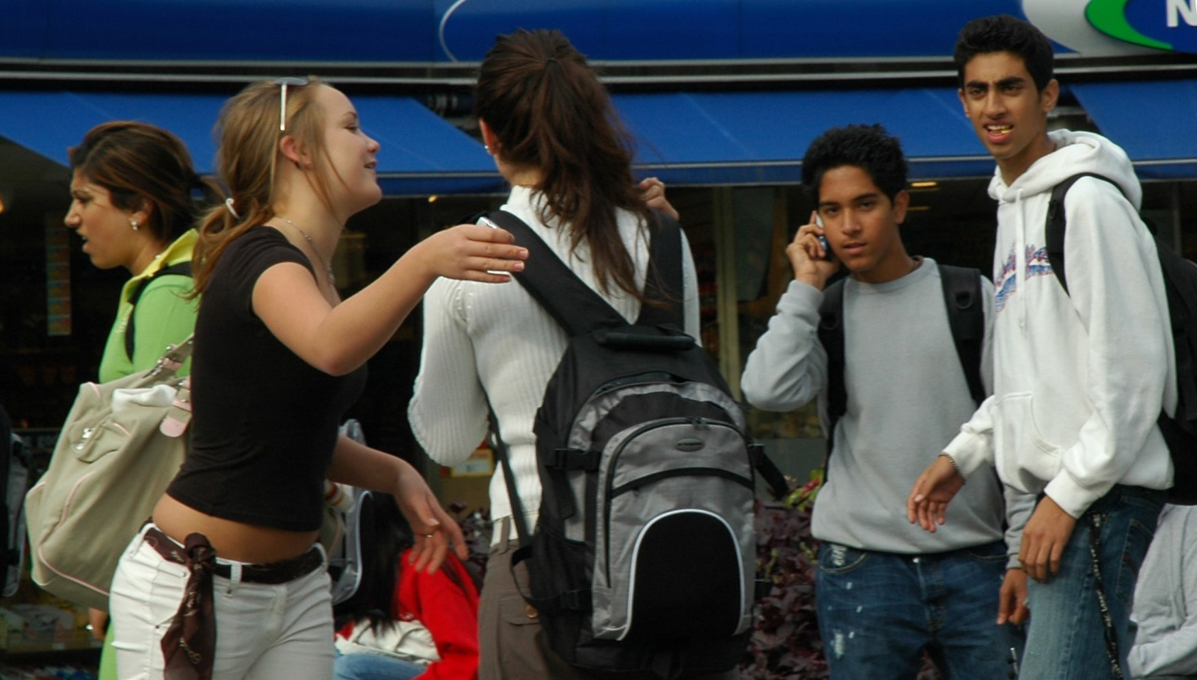
How would you define
“Peer Pressure”?

Slide 10
Why do people give into peer pressure?

Slide 11
computer assignment
To complete the rest of your notes, and understand how peer pressure works, you will go to http://www.thecoolspot.gov/
-follow directions in your packet!

Slide 12
Group Scenarios

Slide 13
In groups of 2-3, you will be given a scenario. You need to present how you would refuse the peer pressure

Slide 14
Scenario #1
You are hanging out at the park on a weekend with all your friends. There are a few people there who you don’t know very well, but they seem super cool, so you want them to like you. Hazel, a girl who is popular at school mentions her older brother is having a party tomorrow night, and there will be alcohol there. “You all have to come and try it! I’ve heard parties can be way more fun with alcohol.”

Slide 15
Scenario #2
During lunch, you and your friends are all sitting together at a table together. Two of the cutest 9th grade boys come up to you and your friend and ask if you want to come hang out with them after school. These boys are known to smoke after school, and are mean to kids who don’t smoke with them. Your friend says “I don’t think that is a good idea. I know you two smoke, and I don’t want to be around that” The boys start laughing and making fun of your friend. They turn to you and ask “What about you? Are you going to be a lame-o nerd like her or will you be cool and come hang with us?”

Slide 16
Scenario#3
You are visiting your grandparent’s farm during Spring Break with all your extended family you haven’t seen for almost a year. Your favorite cousin Todd, tells you to meet out by the river later that night. You are excited to catch up with Todd, and meet him as planned. Todd tells you that he is captain of his football team, and all the guys thing he the bomb. Your stomach sinks when he pulls out a bottle of pills. “This is your ticket to the good life man” and he offers you a handful to keep and try. “Where did you get these? Are these yours?” you ask. “Nah man, it doesn’t matter. These will make you feel good all the time, I know how bad you wanna be Captain, these will make you a better player, and a cooler guy!”

Slide 17
Scenario #4
You recently were in trouble at school and your parents were really upset. You are working hard to earn their trust back, and hope that they will see you can be responsible and make good choices. You talk your parents into letting you hang out with some friends over the weekend. Your parents tell you as they drop you off, that if there are any drugs or alcohol to call them and they will come get you. You are so excited to see your friends again after being grounded for so long! As soon as you walk in, you see a lot of other people with your friends you don’t know, and you smell weed. “What’s going on?” you ask. Your friends tell you that they met some new people who are showing them how to relax and have a good time. You say :“My parents will kill me!” And everyone starts laughing and making fun of you for being a “goody-good” “They won’t know!”

Slide 18
Scenario #5
Your parents are gone for the night and you are home working on homework. Your friend texts you to see what you are up to. Once he finds out that your parents are gone he wants to come over! “Perfect dude! I have some new stuff we wanna try and we can’t find anywhere to do it without parents! We will be over in a few minutes” he texts. You know that he means drugs when he says “new stuff” and you know your parents do not allow you to have friends over when they are gone, plus you have a lot of homework to finish.

Slide 19
Scenario #6
You love dancing, and are so excited to go to a dance party that everyone has been talking about all month. As soon as you get there, someone offers you something that looks like a drug you learned about in health class. “This will make tonight unreal, this literally makes you see and feel the music, and makes dancing way more fun!” Your friends eagerly take the drug and tell you that you are stupid if you don’t try it at least one time.

Slide 20
Scenario #7
You're at the high school basketball game, and afterwards everyone is going to the field to hang out. You are having a great time just goofing off with your friends when some older high schools students come over. They take out some cigarettes and start smoking. “You wanna try one?” One of the girls ask. “It will help you stay skinny” she says “Plus how freaking cool do we look smoking? You need some help looking cool, this will help”

Slide 21
Exit Ticket:
1. List one technique people use to pressure their peers
2. List two quick tips to an
effective peer pressure
refusal

