Slide 1
The Dangers of eating unhealthy

Slide 2
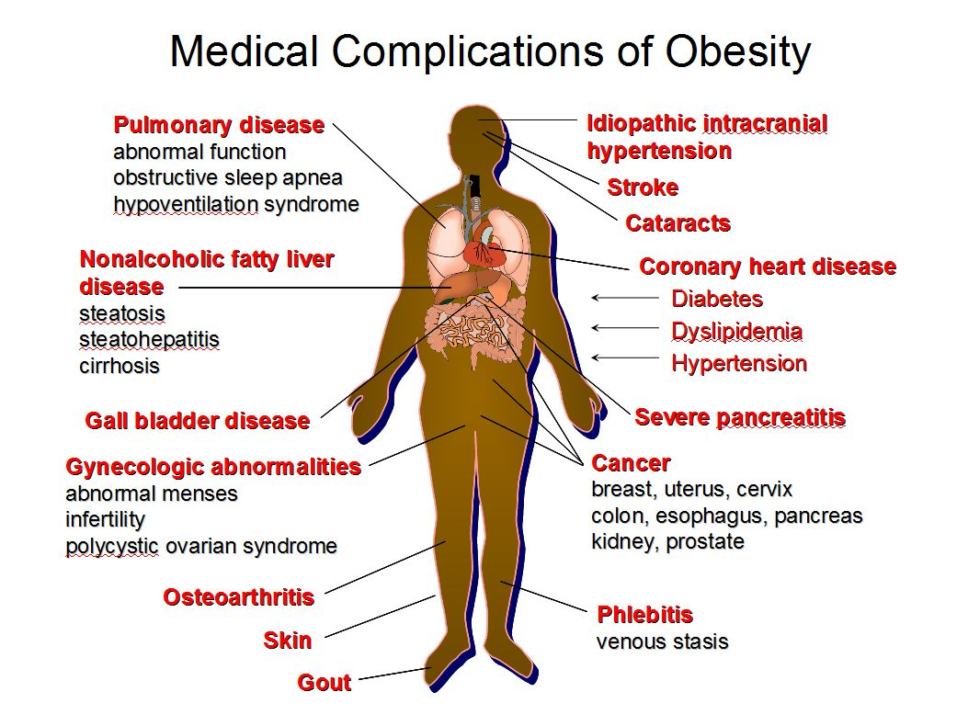

Slide 3
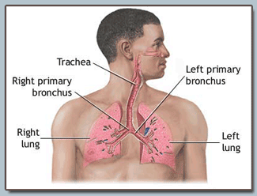
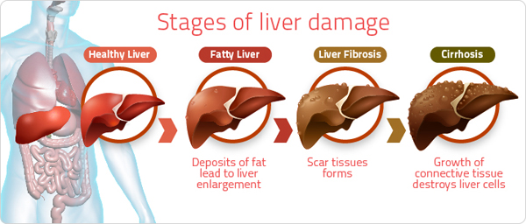
Dangers of Obesity
Pulmonary vascular disease- affects the blood vessels that go to, and from, the lungs.
-Makes it more difficult to breath.
Nonalcoholic fatty liver disease - Too much fat gathers around the liver, causing scars.
-This also can happen to people who drink too much

Slide 4
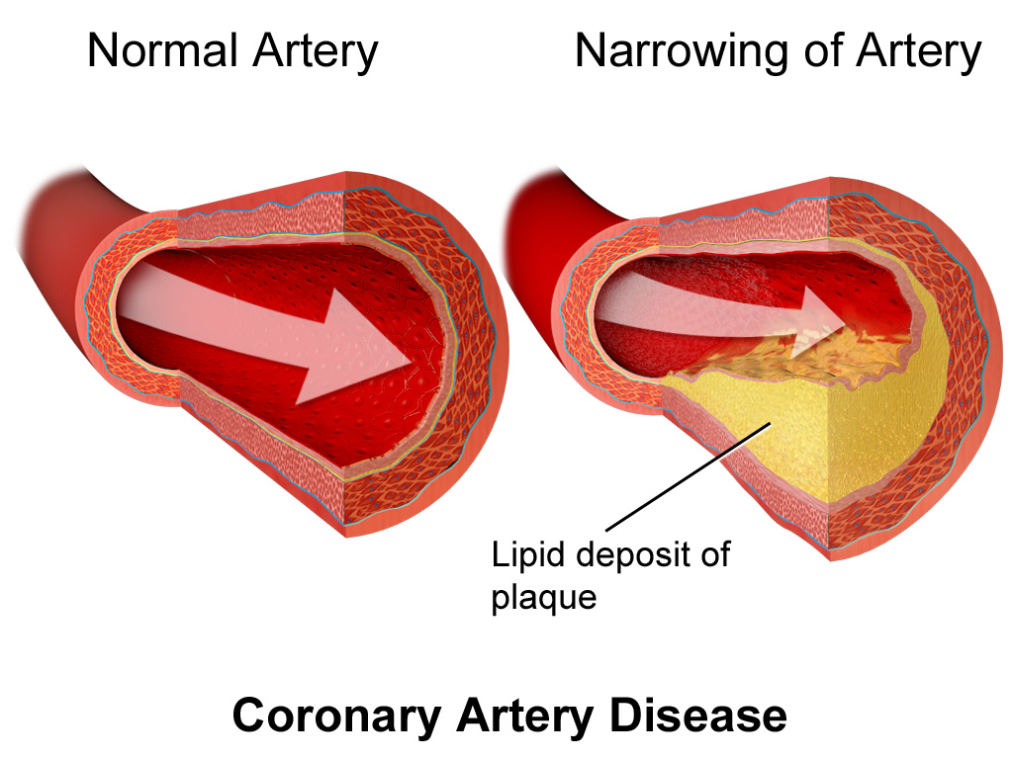
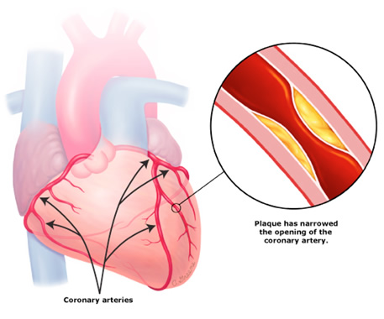
Coronary heart disease (CHD) - Too much fat clogs the blood vessels going to and from the heart.

Slide 5
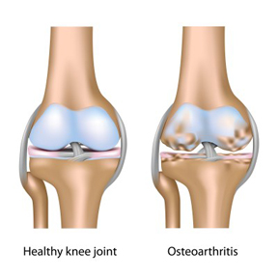
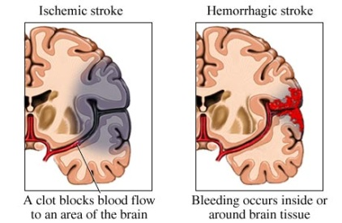
Osteoarthritis - Cartilage between joints wears away.
Causes stiffness and pain
A stroke happens when blood flow to a part of the brain stops. A stroke is sometimes called a "brain attack." If blood flow is stopped for longer than a few seconds, the brain cannot get blood and oxygen. Brain cells can die, causing permanent damage.

Slide 6
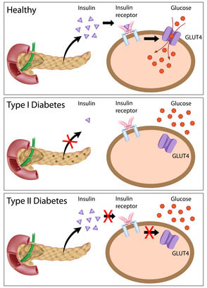
Diabetes - when your body cannot get glucose to the cells.
Type I- When your body cannot produce insulin
Genetic/born with the disease.
Type II- When your body cannot use the insulin it makes
Developed due to poor diet.
If not treated the tissues in your body starve, and can die. Can also lead to blindness, and amputation of limbs.

Slide 7
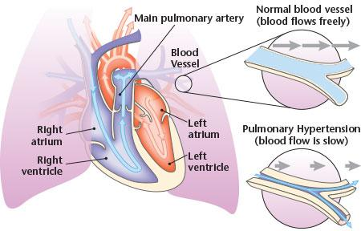
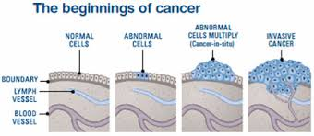
Hypertension -abnormally high blood pressure.
-Overworks the heart which can lead to a heart attack.
Cancer -The spreading of abnormal cells in the body.

