Slide 1
Sexually Transmitted Diseases

Slide 2
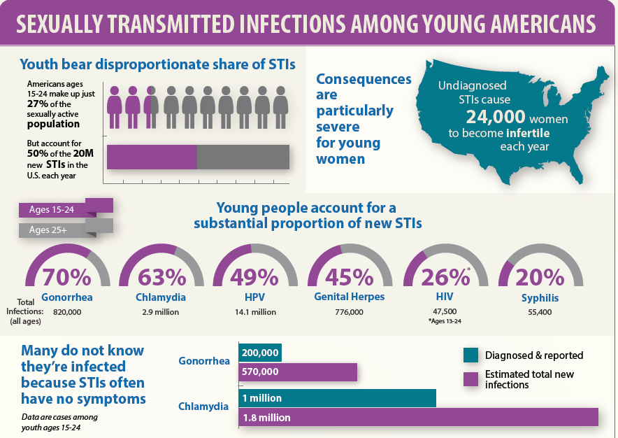

Slide 3
Sexually Transmitted Diseases
Sexually Transmitted Diseases are acquired during unprotected sex with an infected partner.

Slide 4
Sexually Transmitted Diseases
Viral Bacterial Parasitic
Human Immunodeficiency Virus (HIV) Gonorrhea Trichomoniasis
Herpes Syphilis Scabies
HPV (Human Papillomavirus) Chlamydia Pubic Lice
Hepatitis

Slide 5
Viral vs. Bacterial vs. Parasitic
Bacterial and Parasitic sexually transmitted diseases can usually be treated with antibiotics and anti-parasitic medication.
Viral sexually transmitted diseases CANNOT be cured by antibiotics. Once you have them, you have them for LIFE.

Slide 6
Asymptomatic
The majority of sexually transmitted diseases either do not produce any symptoms or signs, or they produce symptoms that are unnoticed. Consequently, many infected persons do not know that they need medical care.

Slide 7
STDs in Men vs. Women
Women suffer more frequent and more serious STD complications than men.
Why?

Slide 8
Women and STDs
Women’s reproductive organs are all on the inside.
Many STDs are asymptomatic (without symptoms) and may not know that they are sick, and therefore many delay treatment.
Complications of STDs in Women:
pelvic inflammatory disease
ectopic pregnancy (pregnancy outside the uterus)
infertility
chronic pelvic pain

Slide 9
What decreases the risk for getting an STD?
Sexual Abstinence before marriage (100% effective)
Being in a long-term monogamous relationship
Avoiding the use of drugs/needles(for the spread of HIV and Hepatitis)

Slide 10
Treatment of STDs
Early detection is CRUCIAL to diagnosing, treating and preventing transmission of sexually transmitted diseases.

