Slide 1
Relationships and Communication

Slide 2
What are qualities that define a romantic relationship?

Slide 3
Characteristics of a Healthy Relationship
Honesty and Trust
Giving real compliments
Discussing problems
Using “I” messages to share feelings
Admitting mistakes
Asking (not accusing) each other about rumors

Slide 4
Characteristics of Healthy Relationships
Emotional Respect
Disagreeing without put downs or threats
Respecting their right to be safe and to control their own body and decisions
Caring to find out their point-of-view

Slide 5
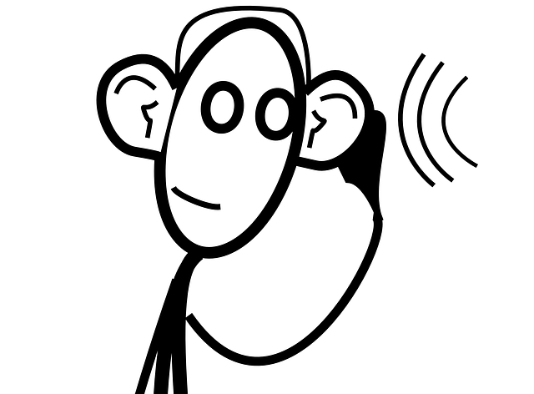
Characteristics of a Healthy Relationship
Listening
Asking what they think and how they feel
Empathize by putting yourself in their shoes
Saying what we think we heard to check for understanding
Asking what is important to them

Slide 6
Characteristics of a Healthy Relationship
Freedom and Encouragement
We have the right to our own and support each other’s right to have opinions, feelings, space, activities, friends and dreams
Expressing fears, instead of claiming ownership when jealous
Either person can decide to break up.

Slide 7
What are ways you can develop and maintain a healthy relationship based on characteristics we have discussed?

Slide 8
Ways to Strengthen Relationships
Be aware of what you want for yourself, and for your relationship.
Let one another know what your needs are and be able to communicate them assertively.
Do not demand that a partner change to meet all of your expectations.
Realize that healthy relationships take continual work and effort to maintain.

Slide 9
Things to consider in a relationship
Similar values and standards
Parents approve
Close to your own age
More than physical attraction

Slide 10
Communication
Communication is a vital component to any relationship.

Slide 11
Communication Continuum

Slide 12
Appropriate Ways to show Affection:
Showing Respect for their personal space and boundaries.
(This is why communication is so important!)
Complimenting and showing interest, not criticizing and belittling.
Respecting their right to be safe and to control their own bodies and decisions.

