Slide 1
Portion Sizes

Slide 2
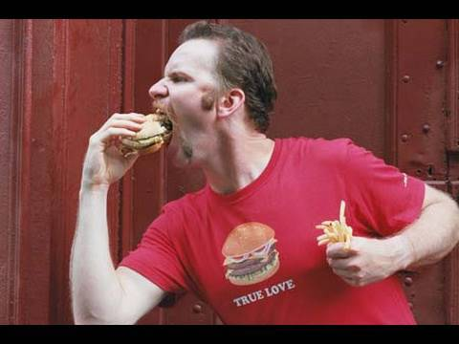
How have portion sizes changed?

Slide 3
How much is...
1 cup

Slide 4
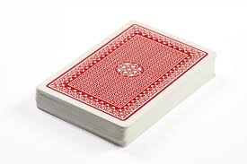
How much is...
3 ounces

Slide 5
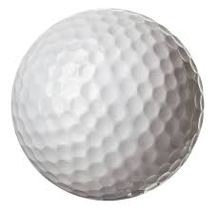
How much is...
2 tablespoons

Slide 6
Group Activity- Food Plate
You will be creating a meal using objects your group creates in order to represent the amount of servings you need from each food group.
Step 1
In your group identify objects that represent portion sizes for fruits, vegetables, grains, protein and dairy that you need in one meal.
Example: fruit= a pair of rolled up socks.
Step 2
Draw each object on the plate provided, and label each item with the food it represents.
Be sure to include all the food groups on your plate.
*MAKE SURE YOUR NAME IS ON THE BACK OF YOUR PLATE.*

Slide 7
How can we control our portion sizes?
In partners, come up with at least one tip for how we can control our portion sizes.
Examples:
Ask for a to-go box as soon as you order your meal at a restaurant.
Keep a pack of sweet gum with you to control your sweet tooth.

