Slide 1
Peer Pressure

Slide 2
Decide Early

Slide 3
What is peer pressure?
Pressure is feeling like you are pushed to make a certain choice (good or bad).
Peer is someone in your own age group.
So...someone give me a definition of peer pressure.
Notes:
Your classmates keep asking you to have them over because you have a pool, everyone at school is wearing a brand name shoe so you do too, and your best friend begs you to go running with her because you both need more exercise, so you go too.

Slide 4
What is so hard about avoiding peer pressure?
What do you think?
- Think - Pair - Share -
We want our peers to like us and we want to feel accepted!

Slide 5
Pressure Point

Slide 6
In order to stand up to peer pressure, we need to be able to recognize it.
Peer Pressure Bag of Tricks
1. Rejection 2. Put downs 3. Reasoning 4. Unspoken Pressure

Slide 7
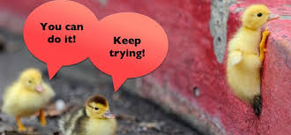
Is all peer pressure bad?
No! Have you ever pushed a friend to do something positive or to avoid something bad?
What are some good things friends can pressure each other to do?

Slide 8
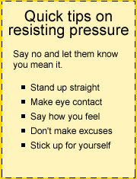
Let’s practice, but first go over some
You have the right…
To say, “NO.”
Not to give a reason why.
To just walk away.

Slide 9
Scenario #1
You recently were in trouble at school and your parents were really upset. You are working hard to earn their trust back, and hope that they will see you can be responsible and make good choices. You talk your parents into letting you hang out with some friends over the weekend. Your parents tell you as they drop you off, that if there are any drugs or alcohol to call them and they will come get you. You are so excited to see your friends again after being grounded for so long! As soon as you walk in, you see a lot of other people with your friends you don’t know, and you smell weed. “What’s going on?” you ask. Your friends tell you that they met some new people who are showing them how to relax and have a good time. You say, “My parents will kill me!” And everyone starts laughing and making fun of you for being a “goody-good” “They won’t know!”

Slide 10
Scenario #2
During lunch, you and your friends are all sitting together at a table together. Two of the cutest 9th grade students come up to you and your friend and ask if you want to come hang out with them after school. These students are known to smoke after school, and are mean to kids who don’t smoke with them. Your friend says “I don’t think that is a good idea. I know you two smoke, and I don’t want to be around that” The students start laughing and making fun of your friend. They turn to you and ask “What about you? Are you going to be lame like your friend or will you be cool and come hang with us?”

