Slide 1
Female and Male Reproductive Anatomy Review

Slide 2
Understanding the Reproductive System
Respect for human sexuality is dependent in part upon a factual understanding of anatomy, physiology and the growth and development of the reproductive systems.

Slide 3
Our Bodies and health
Caring for the reproductive system is essential to maintaining a healthy life. There is a need for informed, responsible behavior with respect to reproduction.

Slide 4
It is important for you to understand how your body functions. Lack of information can contribute to irresponsible behavior that can have a devastating effect.

Slide 5
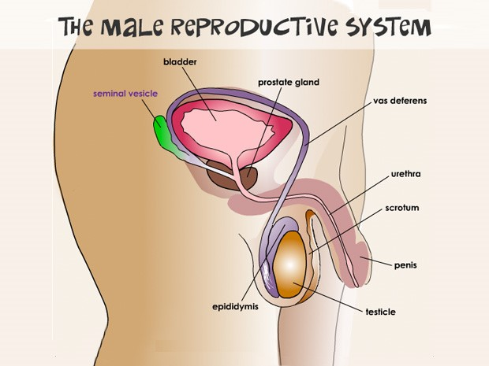

Slide 6
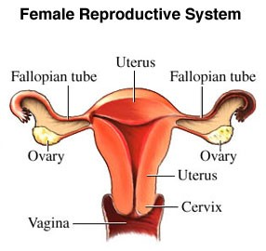

Slide 7
Female Reproductive Anatomy
Process of Menstruation

Slide 8
Process
Hormone secretion (remember the ones we talked about?) cause an egg in an ovary to mature.

Slide 9
Menstruation Cont’d
About once a month, that tiny egg leaves one of the ovaries (ovulation) and travels down one of the fallopian tubes.

Slide 10
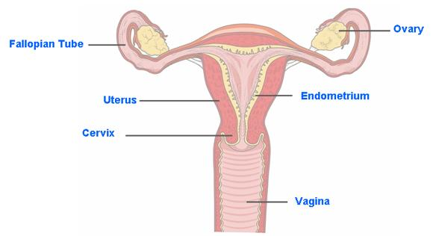
Menstruation cont’d
In the days before ovulation, certain hormones stimulate the uterus to build up its lining with extra blood and tissue making the walls of the uterus thick and cushioned. This happens to prepare the uterus for pregnancy.

Slide 11
Menstruation cont’d
If the egg isn’t fertilized (sperm meets egg), the egg will not attach to the wall of the uterus, and the uterus sheds the extra tissue lining.
The blood, tissue and unfertilized egg leave the uterus, going through the vagina on the way out of the body. This is the mentrual period.

Slide 12
This process happens almost every month for several decades (except of course, when a wife is pregnant) until the woman reaches menopause and no longer releases eggs from her ovaries.

Slide 13
Irregular periods are common in girls who are just beginning to menstruate. It may take the body a while to sort out all the changes going on.

Slide 14
Male Anatomy
Even a mild injury to the testicles can cause severe pain, bruising, or swelling. Most testicular injuries occur when the testicles are:
Struck
Hit
Kicked
Crushed

Slide 15
Taking care of your body:
Men are often unaware of the need for regular self-examinations and annual physician’s examinations. Beginning at puberty, with the enlargement of the testicles, every boy and man should examine his testicles once a month. Any changes in the size or shape of the scrotum or testicles requires immediate medical attention.

