Slide 1
Lowe’s Class Rules
Expectations

Slide 2
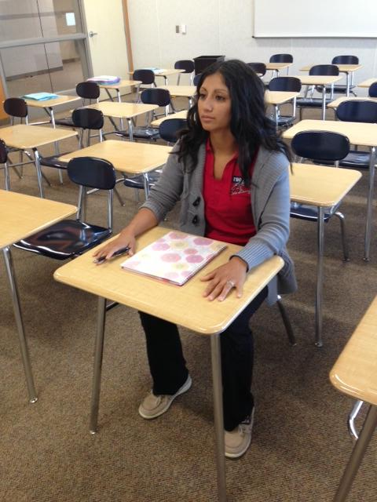
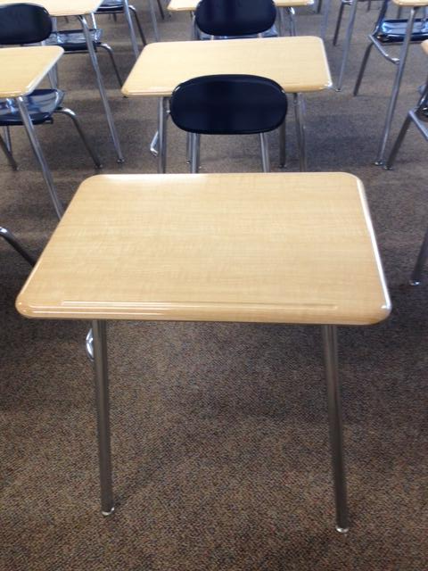
Attendance
Cool
Not Cool

Slide 3
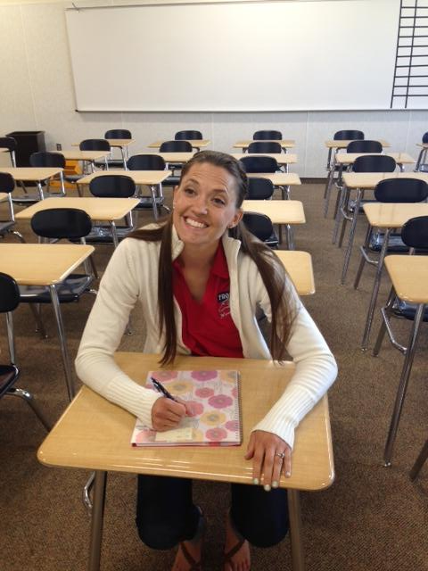
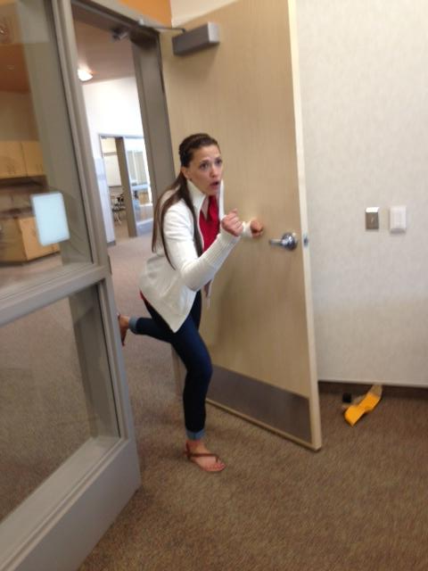
Tardy
Cool
Not Cool

Slide 4
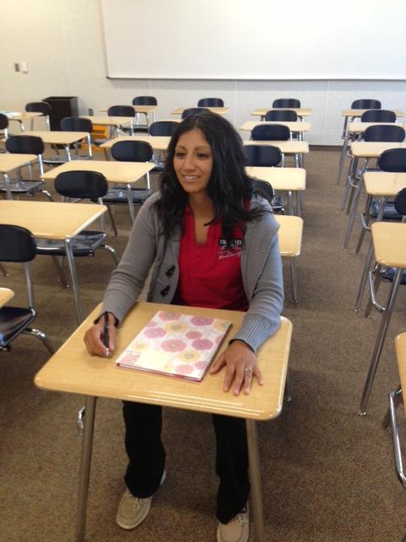
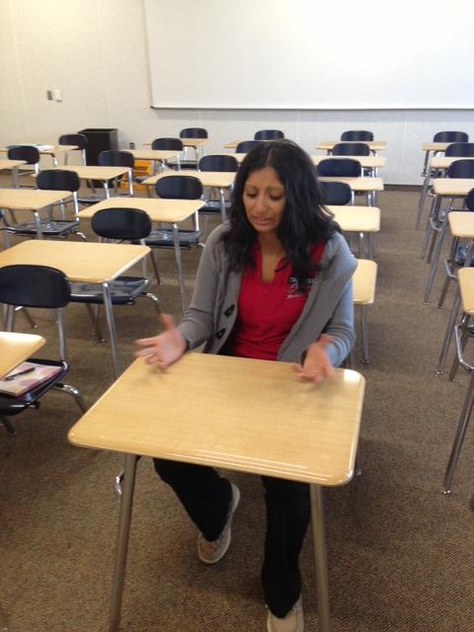
Preparedness
Cool
Not Cool

Slide 5
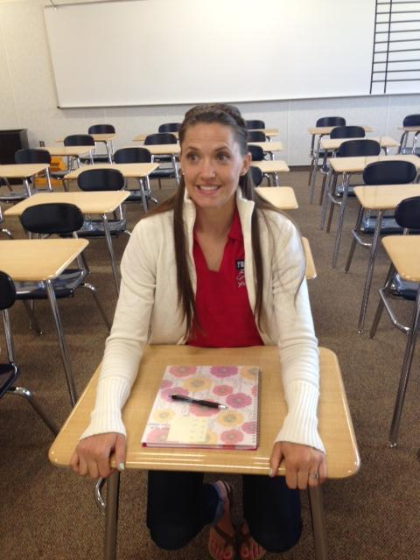
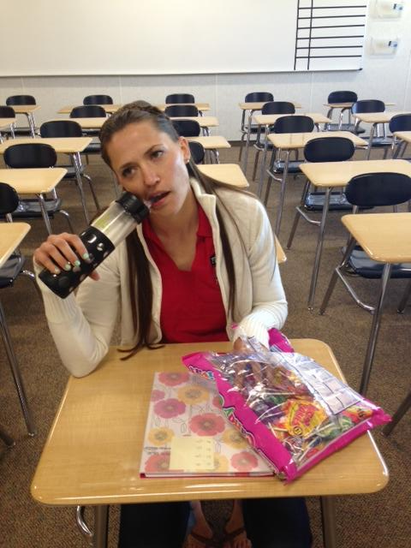
Food & Drink
Cool
Not Cool

Slide 6
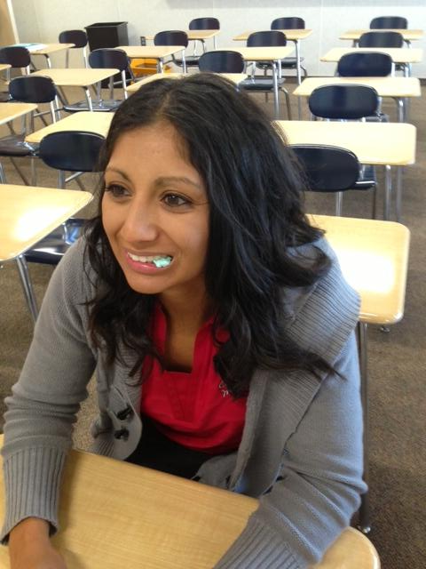
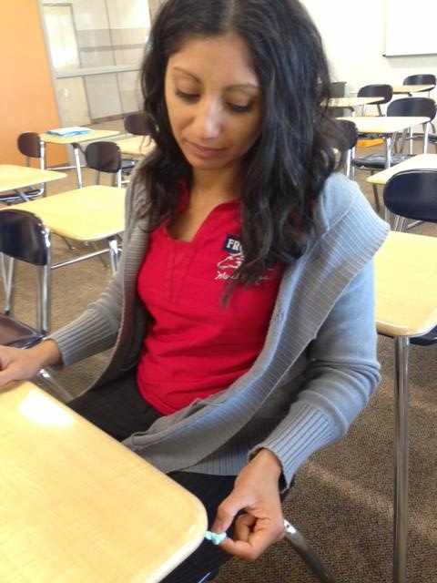
Gum
Cool
Not Cool

Slide 7
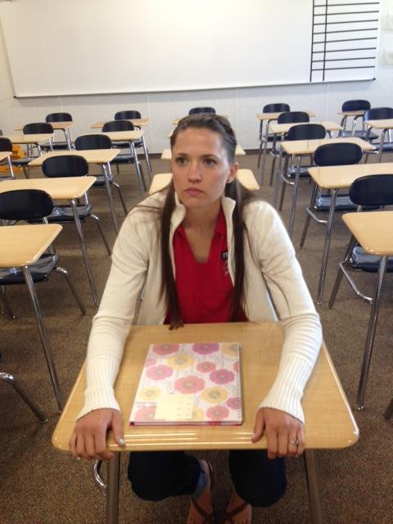
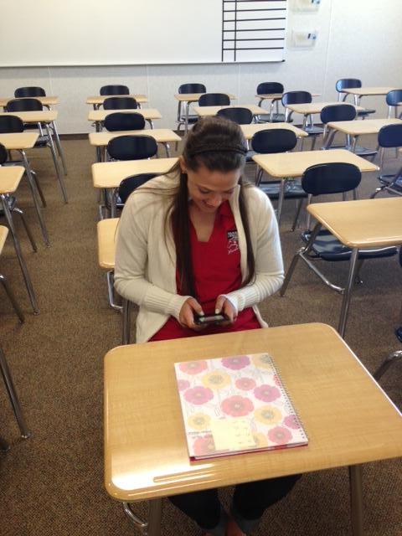
Phones
Cool
Not Cool

Slide 8
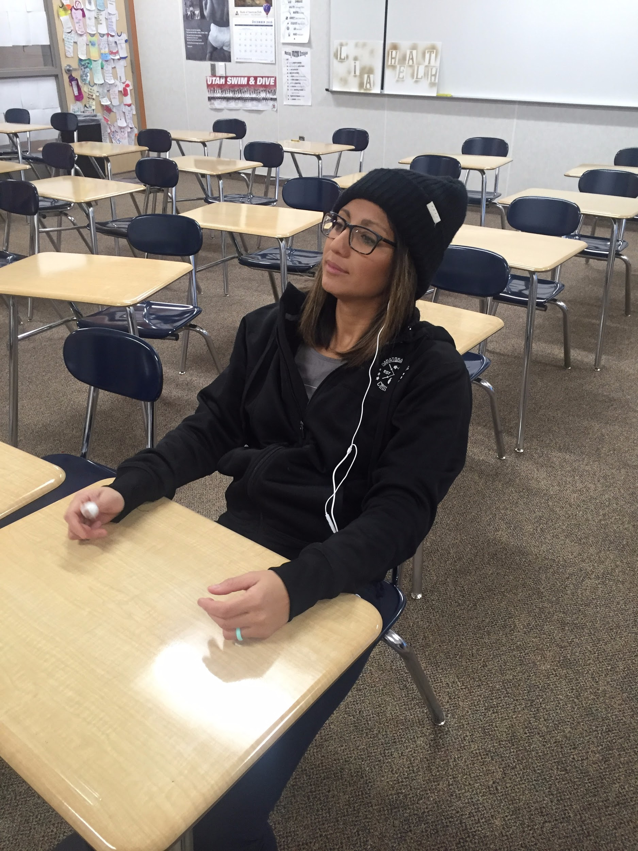
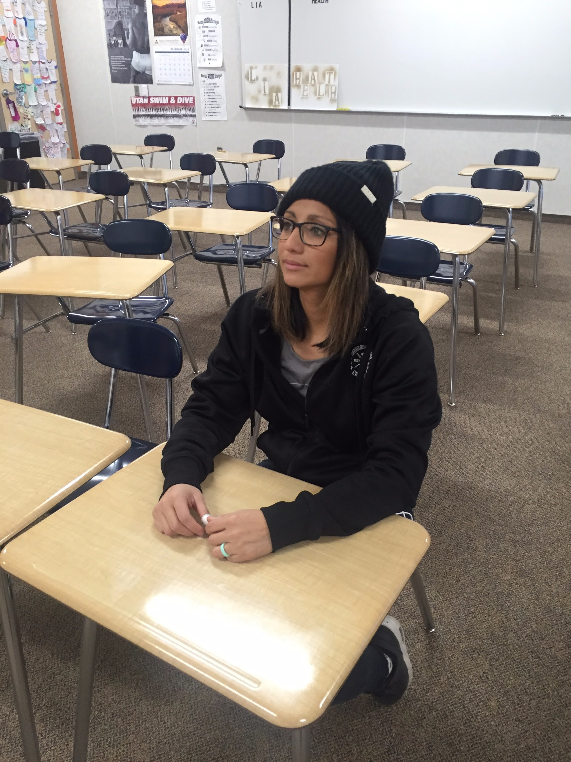
EAR BUDS IN
Cool
Not Cool

Slide 9
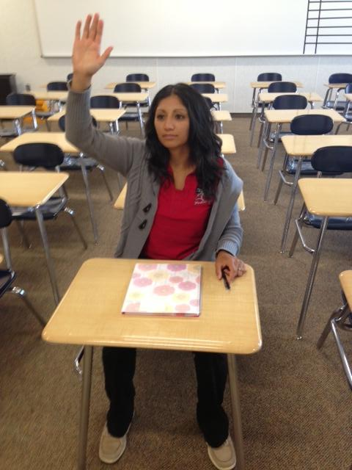
Hand-raising
Cool
Not Cool

Slide 10
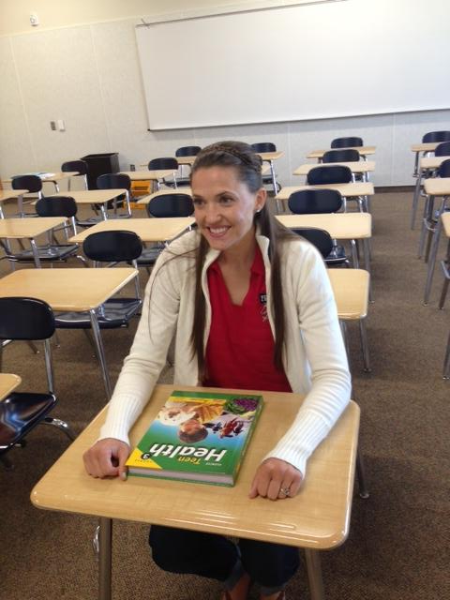
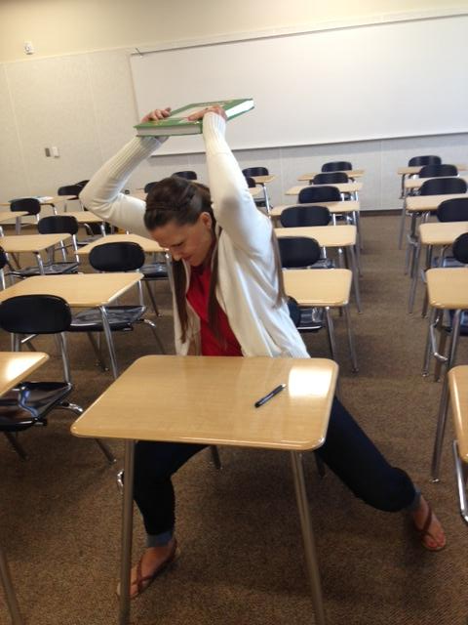
Treatment of Property
Cool
Not Cool

Slide 11
BE RESPECTFUL AND WATCH YOUR COMMENTS

Slide 12
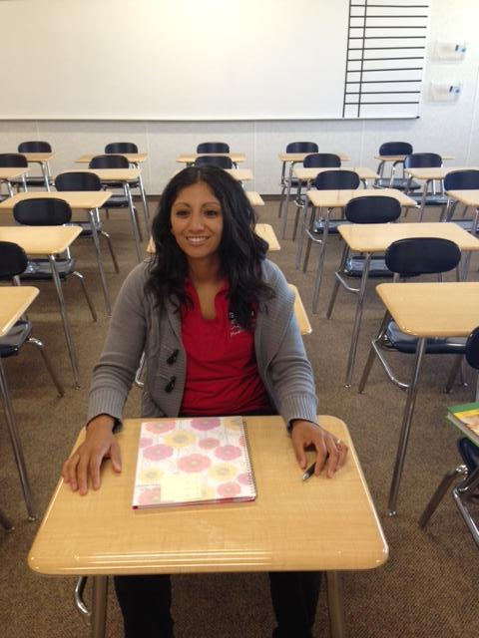
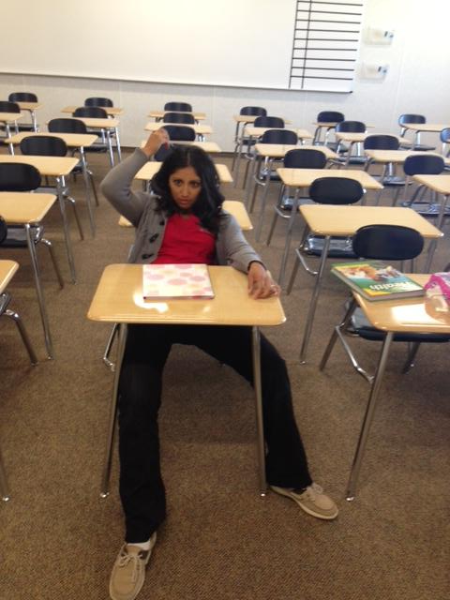
Attitude
Cool
Not Cool

Slide 13
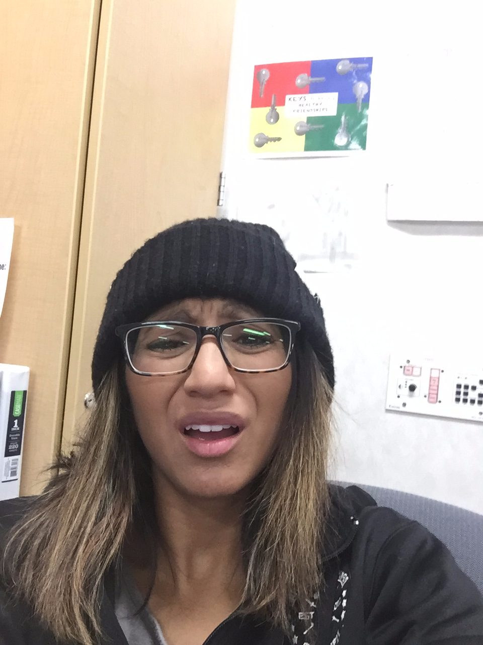
NO WHINNING IF I SAY YOU CAN’T DO SOMETHING

Slide 14
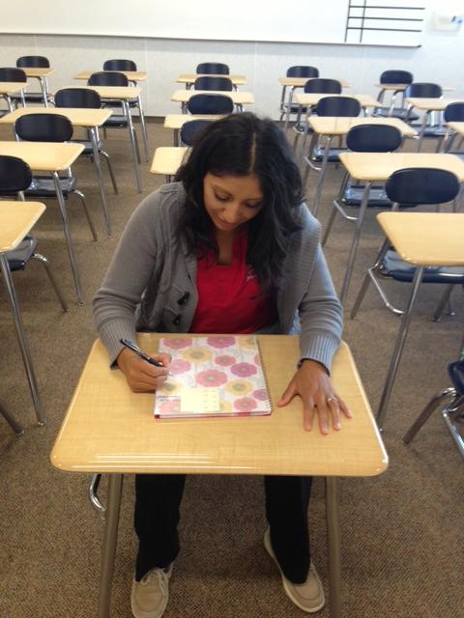
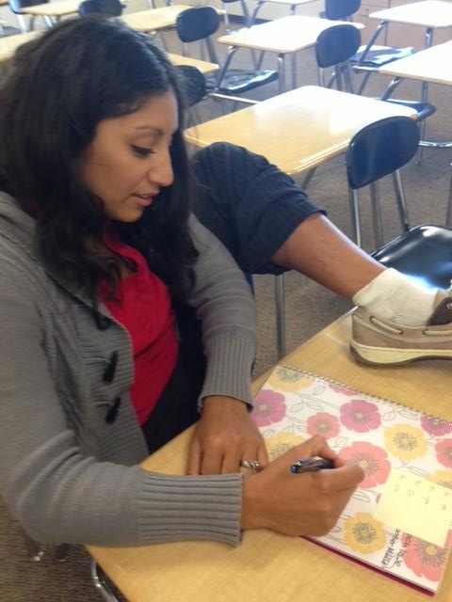
Cheating
Cool
Not Cool

Slide 15
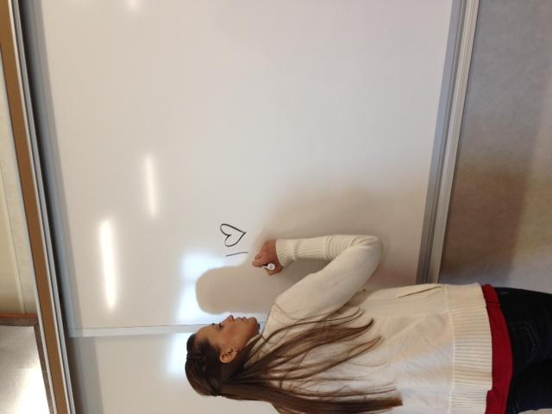
Classroom Appearance
Cool
Not Cool

Slide 16
Classroom behavior issues- “I am not your babysitter, I am your teacher”
1. Warning
2. Sit at desk by teacher
3. parent call
4. Student Center
(Tardy Office)

Slide 17
Bathroom
Raise your hand/or come to my desk and ask me to go to the restroom
Grab the hall pass (NO DETOURS)
Make sure you return the hall pass

