Slide 1
5 Elements of Fitness

Slide 2
What does it mean to be physically fit?
It’s not all about looking lean or buff!
It’s determined by the ability of the muscular, circulatory, and respiratory systems to meet certain demands.
What does circulatory and respiratory mean?
We measure our fitness level using the 5 ELEMENTS OF FITNESS.

Slide 3
Five Elements of Fitness
#1 Cardiovascular Endurance
#2 Muscular Endurance
#3 Muscular Strength
#4 Flexibility
#5 Body Composition

Slide 4
Cardiovascular Endurance
How efficiently your heart & lungs work when you exercise & how quickly they return to normal when you stop.
When you have high cardiovascular endurance, you can work or play for long periods without running out of steam.
Activities that build cardiovascular endurance:
Swimming, cycling, walking, jogging, running
Notes:
Running, biking, jump rope, dancing, anything that gets you out of breath

Slide 5
Example: Running!

Slide 6
Muscular Endurance
A muscle’s ability to perform a continuous effort without fatiguing.
Activities that build muscular endurance:
Cycling, step machines, sit up tests

Slide 7
Example: Push-ups!

Slide 8
Muscular Strength
The amount of force a muscle can exert, in a single effort.
Activities that build muscular strength:
Bench press, leg press, bicep curl
Notes:
Weight lifting, pushups, sit ups, lunges, anything that burns!

Slide 9
Example: Bicep curls!

Slide 10
Flexibility
The ability of your body’s joints to move easily through a full range of motion.
Flexibility permits bending, turning, & stretching
Activities that build flexibility:
Regular stretching, bending, and twisting exercises such as yoga and karate.
Notes:
Stretching, yoga, karate, skateboarding

Slide 11
Example: Stretching!

Slide 12
Body Composition
The ratio of body fat to lean body tissue (bone, muscle, and fluid)
In more simple words: How much of your body weight is body fat, muscle, & other lean body tissue.
Too much body fat can lead to serious health problems.
How to measure:
Underwater weighing, skinfold test, BMI (Body Mass Index)

Slide 13
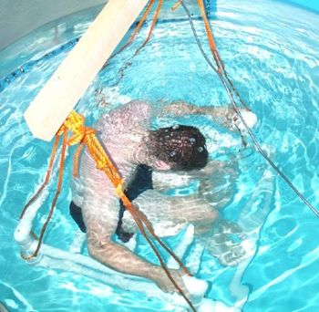
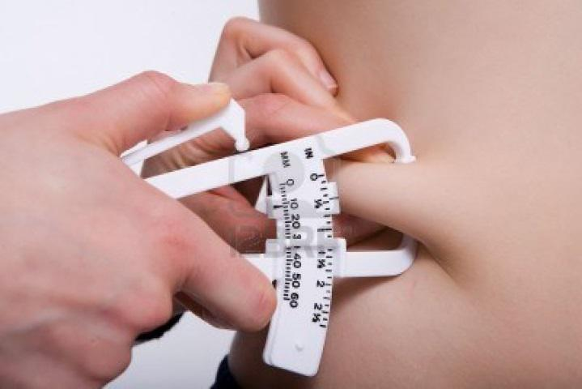
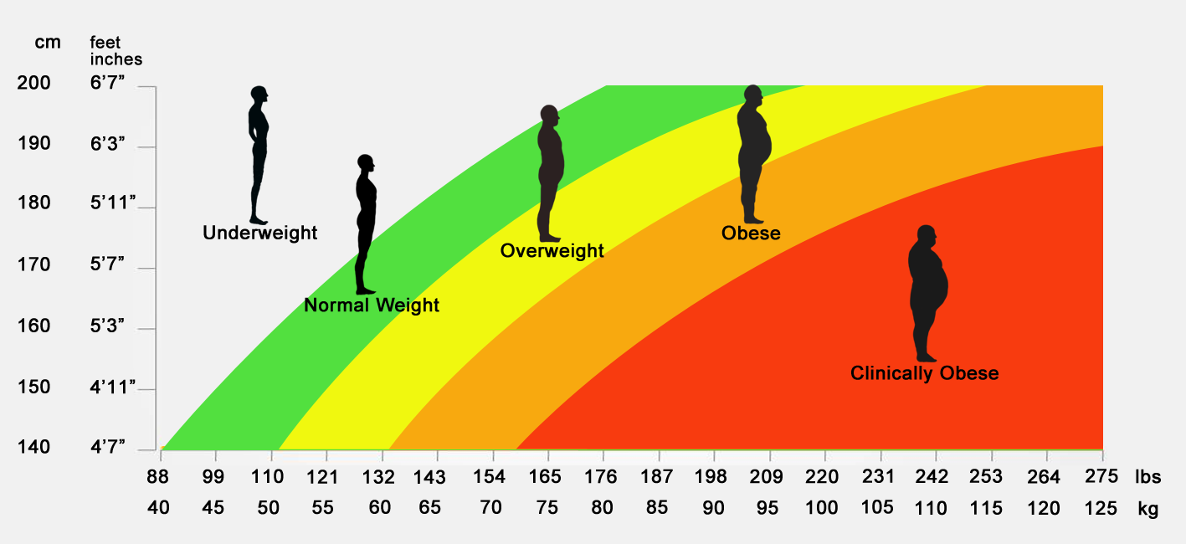
Skinfold Test
Underwater weighing
B
M
I

Slide 14
Fitness & a Healthy Attitude
What else determines level of fitness?
Heredity: The passing of traits from parents to their children.
Example: Speed is a trait that is often passed down from parents.
Goal Setting
Focus on what you can do!

Slide 15
Remember…
Improvement is possible in every area of fitness, which boosts your physical health.
Everyone has limits. You can only make so much progress in a short period of time.

