Slide 1
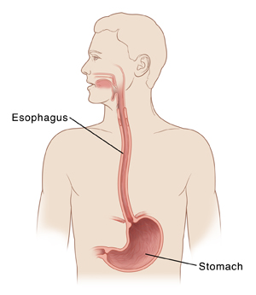
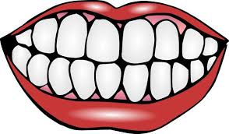
Mouth/Esophagus (esophagus: carries food and saliva from mouth to stomach)
Inflammation of the tongue and mouth
Damage to the salivary glands
Increased tooth decay, gum disease, and tooth loss
Mouth cancer
Heartburn

Slide 2
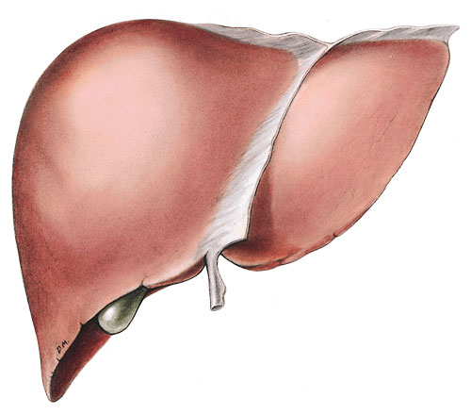
Liver (filters and cleans the blood)
The liver is the organ that takes the most abuse from alcohol consumption.
FATTY LIVER: Liver cells are turned into fat cells. This may be reversed with the abstinence of alcohol. This condition can lead to death if alcohol consumption is not reduced or stopped.
CIRRHOSIS: The most serious form of alcoholic liver disease that occurs when the cells of the liver are damaged and can’t repair themselves.
Live cells die->->Scar tissue forms->->Blood can’t flow through the liver
Once liver cells have been damaged, nothing can be done to repair the liver.

Slide 3
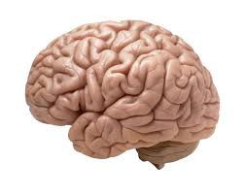
Brain
Alcohol can be very destructive by causing damage to multiple areas of the brain.
Damage to the brain’s neurotransmitters (chemicals that communicate information throughout the brain and body) can result in behavioral and mood changes such as depression, anxiety, memory loss, and seizures.
Alcoholism combined with poor nutrition can cause WERNECKE-KORSAKOFF SYNDROME (WET BRAIN). Alcoholics with “WET BRAIN” experience depression, memory loss, confusion, hallucinations, loss of muscle coordination, and difficulty forming new memories.

Slide 4
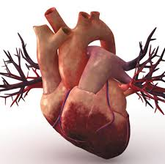
Heart
Over time, too much alcohol begins to weaken the heart muscles which can negatively affect blood flow.
A common condition of alcoholics is CARDIOMYOPATHY. This is where the heart stretches and droops. Some symptoms may be shortness of breath, irregular heartbeat, fatigue, enlarged liver, and persistent cough.
Alcohol also increases the risk of heart attack, stroke, and high blood pressure.

Slide 5
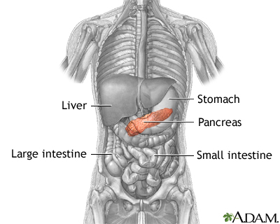
Pancreas (aids in the breakdown of food and produces and secretes insulin in order to control glucose levels)
PANCREATITIS: Inflammation of the pancreas. Symptoms include abdominal pain, nausea, or vomiting, increased heart rate, diarrhea, and fever. Can also cause chronic pancreatitis which slowly deteriorates the pancreas, leading to diabetes or even death.

Slide 6
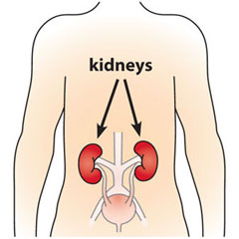
Kidneys (cleanse your blood by removing waste and excess fluid, maintain the balance of salt and minerals in your blood, and help regulate blood pressure)
Damage to the kidney cells
Enlargement of the kidneys
Kidneys are not able to regulate the flow and makeup of fluids in the body
Excessive alcohol use can lead to high blood pressure, which can lead to kidney failure

