Slide 1
Depression

Slide 2
What is depression?
A mood disorder causing a persistent feeling of sadness and loss of interest.
It’s not the same as feeling sad. It is something that interferes with a person’s day-to-day life.

Slide 3
How does a person get depression?
There is not one specific cause, but the following may be risk factors:
Trauma
Genetics
Life circumstances
Brain structure
Some medical conditions
Drugs and alcohol

Slide 4
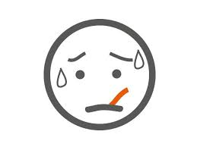
Do you know the symptoms?
Changes in sleep
Changes in appetite
Difficulty focusing
Loss of energy
Loss of interest
Low self-esteem
Hopelessness
Physical aches and pains

Slide 5
