Slide 1
Decision Making

Slide 3
Think about the decisions you have made today.
Did you make good choices? Bad choices?
Easy choices? Hard choices?
Will any of those choices impact your future or other people in your life? In a positive or negative way?

Slide 4
Decision-Making:
The process of making a choice or finding a solution.

Slide 5
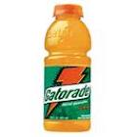
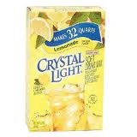
Which drink would you choose?

Slide 6
Why did you choose that one?
There are many different things that influence the choices we make...let’s look on the next slide.

Slide 7
What influences the choices we make?
Media-the media makes me think Gatorade will improve my athletic performance.
Family- I might choose the V8 because my family drinks it and I am used to it.
Friends– I might choose the Sobe because all my friends think it is a cool drink.
Emotions- if I am having a bad day I might want the chocolate milk.
Habits -I need my dr. pepper everyday because I have gotten used to the caffeine.
Esteem - I respect my body and don’t want to put anything harmful into it, so I might choose water.
Values- My coach says carbonation slows you down, I value what my coach says so I choose a non carbonated drink.
**Values have the greatest influence on the choices we make, if we go against a value we feel guilty

Slide 8
Groupwork
You will be divided into 6 groups.
Each group will be responsible for teaching one letter of DECIDE.
In your groups, divide up tasks on the given worksheet.
With the given scenario, create a poster that includes the following:
What your letter stands for.
An example of your step, with the given scenario, and a picture!
Groups will present in order: DECIDE
As groups are presenting, you are filling out the DECIDE chart in your notes.
You have 15 minutes!

Slide 9
DECIDE Scenario
Kendra & Michelle have been best friends for a long time. Recently, Michelle has been spending time with other classmates who ditch school. She has been asking Kendra to come with them. Kendra doesn’t want to lose Michelle as a friend, but she knows that her parents trust her. What is the best choice she can make?

Slide 10
D: Define the Problem
What is it that you are being faced with?

Slide 11
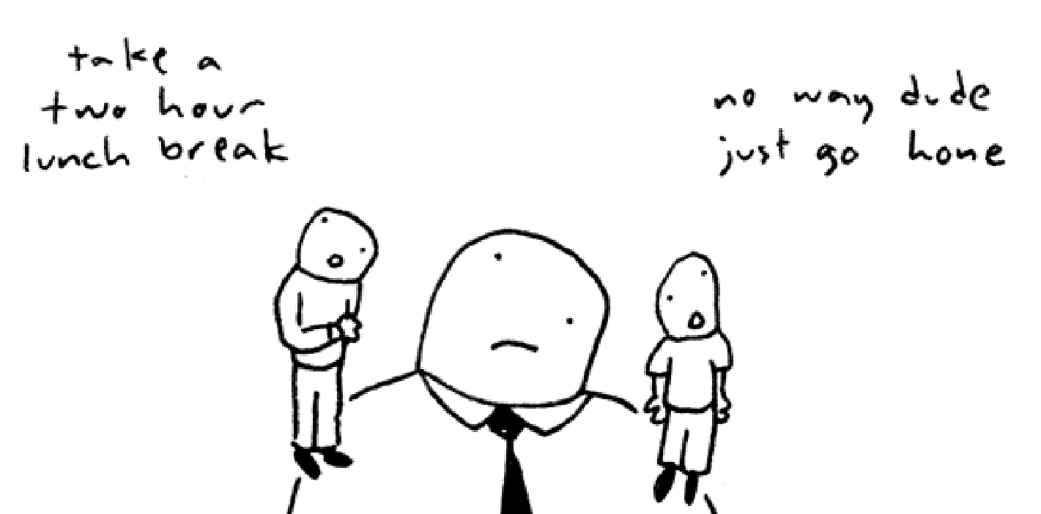
E: Explore your options
What are my options?

Slide 12
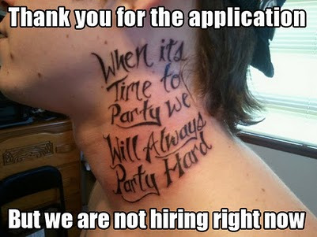
C: Consider the Consequences
What can be potential positive and negative consequences?

Slide 13
I: Identify your Values
What is most important to you? What things are going to influence your choice?

Slide 14
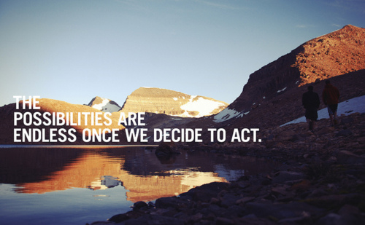
D: Decide and Act
Make a choice and follow through!

Slide 15
E: Evaluate the Results
After you’ve followed through with your choice, determine if it was the right one! What, if anything, could you have done differently? How can you learn from your choice?

Slide 16
Long-term Effects
What are some choices that you are being faced with that can affect your future? (Answer in notes)
Some decisions can affect your future!
How hard do you work in school?
Do you choose good friends?
What type of career do you want?
Do you abuse drugs?
How often do you think of long-term consequences to your actions?

Slide 18
Your Future
Decide now…what do you want your future to look like?
Are you making choices that will get you there? Or are you making choices that will keep you from what you want out of life?
If you’re making bad choices…start making better ones!
What is one better choice that you can start making right now? (Answer in notes)

