Slide 1
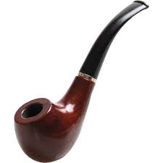
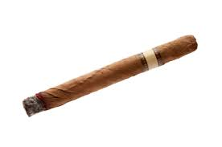
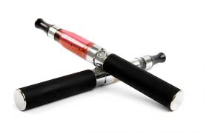
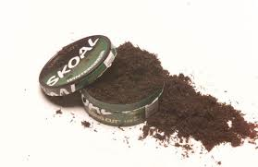
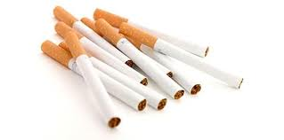
Tobacco

Slide 3
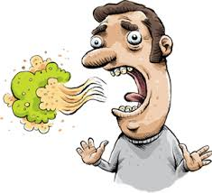
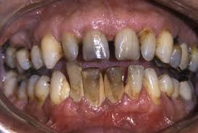
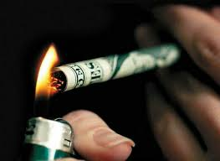
Smoking is one of the worst things you can do to your body!
Here are problems that might affect kids more quickly:
bad breath
yellow teeth
smelly clothes
more colds and coughs
difficulty keeping up with friends when playing sports
empty wallet — cigarettes and tobacco products are very expensive!
Yet every single day, about 3200 kids and teens start smoking.
-kidshealth.org

Slide 4
Here’s some good news...
Most middle schoolers don’t even smoke! Only about 1 in 50 do.
-kidshealth.org
Why do they start?
Fewer people are starting to smoke than a few years ago! Why?

Slide 5
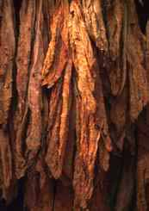
What is tobacco?
It’s a plant that can be smoked in cigarettes, pipes, or cigars.
It’s the same plant that’s in smokeless tobacco (dip, chew, snuff, spit, or chewing tobacco)
It contains NICOTINE (along with thousands of others harmful products).
It gives a temporary pleasant feeling.
VERY addictive.

Slide 6
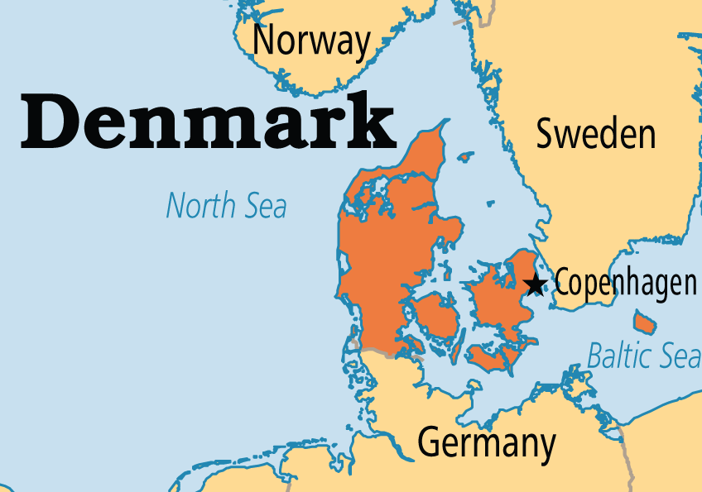
Why is it so bad for you?
Tobacco...
kills up to half of its users.
kills around 6 million people each year.
is one of the BIGGEST health threats the world has ever faced.
World Health Organization

Slide 7
Let’s go for a walk!

Slide 8
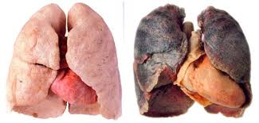
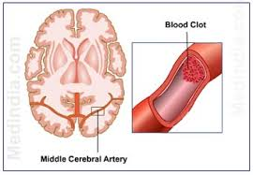
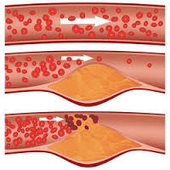
Why is it so bad for you?
Poisonous chemicals in tobacco cause LOTS of diseases…
heart disease & other heart problems
lung diseases
cancer
stroke
These are just a few!

Slide 9
Video

Slide 10
What about E-cigarettes?
Some still contain nicotine
Popcorn lung
There’s still a lot we don’t know!
Anytime you inhale something foreign into your lungs, you are at risk of damaging them!

Slide 11
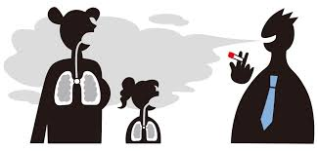
What about secondhand smoke?
What is it?
Smoke that either comes from a burning cigarette or is exhaled by a smoker.
Can secondhand smoke be damaging to our health?
YES! We can get the same illnesses and deadly diseases as a smoker...which stinks, especially if we’ve made the choice NOT to smoke!

Slide 12
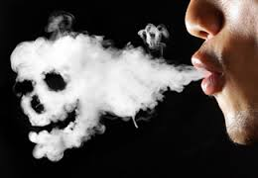
What can we do about it?
Group discussion
How can you avoid secondhand smoke?
What if a friend or family member smokes around you?
You have every right to ask someone to not smoke around you.
If they care about you, they will care about your health and respect your request.

Slide 13
Bottom Line
You are putting your health at-risk EVERY time you use tobacco (E-cigarettes included).
You never know when you’ll become addicted.
Do yourselves a favor...don’t even start!

Slide 14
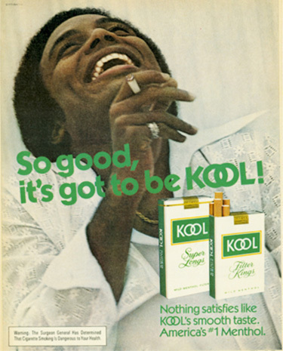
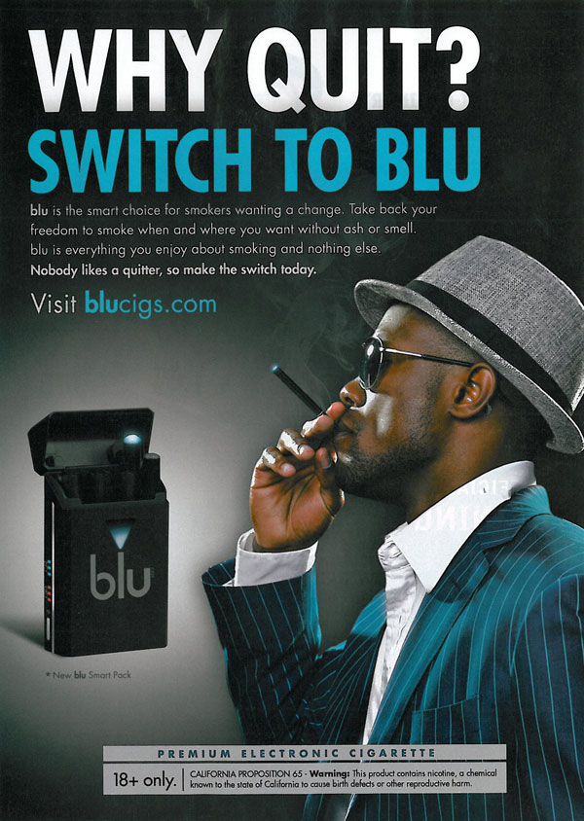
Let’s look at some tobacco ads

Slide 15
Your assignment
In groups of 2 or 3 (or individually)
You are going to create a tobacco ad, but…..you’re going to give the facts!
Here’s an example...
Anti-Tobacco Ad

Slide 17
Instructions
Grab a piece of paper and coloring supplies.
Be creative!

