Slide 1
Other Drugs

Slide 2
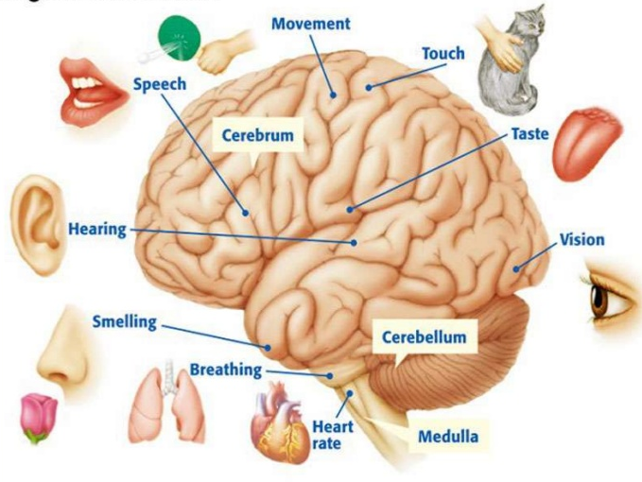
Our brains are AMAZING!
The brain controls every single thing we do!
Around the ages of 14 & 15, we have a MAJOR peak in brain development.
This means our brains are very vulnerable.

Slide 3
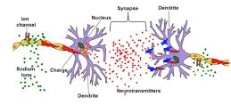
Inside the brain
Neurotransmitters: Molecules that affect how we think and feel.
Neurons: Brain cells that send and receive these chemicals.
One neuron sends a certain message and the other is ready to receive it.

Slide 4
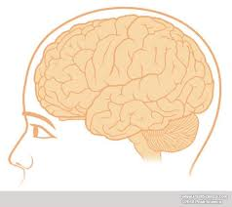
Think of it like this...
Neurotransmitters are like keys.
Neurons are like locks.
Certain keys open certain locks.
So…certain neurotransmitters fit certain neurons.

Slide 5
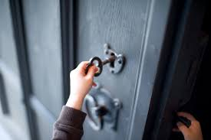
When certain keys fit certain locks, doors are opened to certain thoughts and feelings.

Slide 6
When a certain amount of certain doors are opened we feel → “NORMAL.”

Slide 7
When more of those doors are opened we feel → “EXCITED.”

Slide 8
When less doors are opened we feel → “DEPRESSED.”

Slide 9
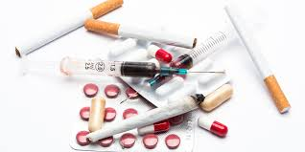
What does this have to do with drug use?
Certain drugs mimic the natural keys (neurotransmitters) and can unlock doors to feelings and thoughts.
This is what happens when someone is “high.” They have quickly opened many doors.

Slide 10
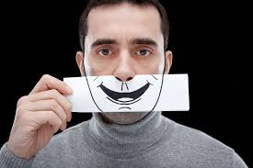
So what’s the problem?
This new artificial high may be off the scale of anything that our brain is use to.
Because of this, the scale breaks and now there’s a new normal.
Our old normal now seems down and sad.
The brain stops making natural neurotransmitters, the drugs leave the body, then what???

Slide 11
How does a person unlock doors and get that good feeling back?
They use again to feel “normal.”
The more fake keys (drugs) that are used, the more the body quits making its own real keys (neurotransmitters).

Slide 12
See why drugs can be so hard to quit???

