Slide 1
Alcohol

Slide 2
Did you know?
Alcohol kills more teens than all other drugs combined.

Slide 3
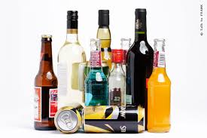
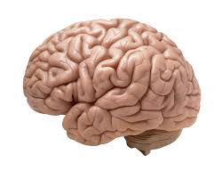
What’s the big deal?
1st: Alcohol is absorbed into the bloodstream.
2nd: It goes to our central nervous system (spine and brain) which controls ALL body functions.
3rd: Our brains don’t stop developing until we are about 25. Your brains are very vulnerable right now!
4th: Legal drinking age is 21.

Slide 4
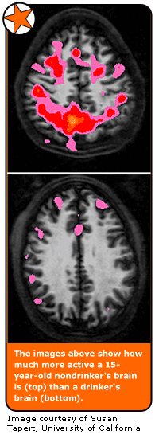
How does it affect the body?
Alcohol is a DEPRESSANT.
Slows functioning of the CNS.
It blocks messages that are trying to get to the brain.

Slide 5
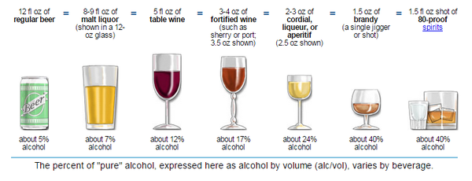
Here’s when things can get really dangerous...
2 important terms:
Alcohol Poisoning: When the body becomes poisoned by large amounts of alcohol.
Binge Drinking: Drinking a large amount in a short period of time (4-5 drinks at a time).
BINGE DRINKING can lead to ALCOHOL POISONING!
90% of alcohol consumed by people under 21 in the U.S. is in the form of BINGE DRINKING.
-drugfreeworld.org

Slide 6
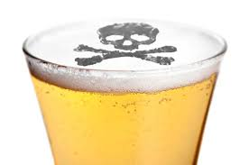
How do I know if someone has alcohol poisoning?
Alcohol poisoning is the most life-threatening consequence to binge drinking.
The body’s involuntary reflexes are affected - breathing & gag reflex.
SIGNS: Write down 3
extreme confusion
inability to be awakened
vomiting
seizures
slow or irregular breathing
low body temperature
bluish or pale skin

Slide 7
Lives Affected
Choose 1 person from the video - In your packet, share specific ways their life will forever be affected by drinking and driving.

Slide 8
What if you’re worried about someone else’s drinking?
Remember...
An alcoholic won’t stop until they recognize the problem and want help.
What you can do:
Express your concern (Remember I-statements?)
Keep them safe - How?
Keep yourself safe - How?
Get support - Where? Adults, friends, counselors, organizations

Slide 9
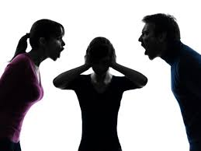
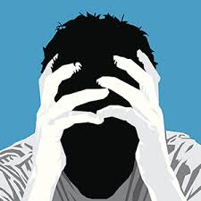
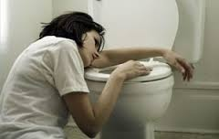
WHy shouldn’t you drink?
Right now you’re not of legal age.
Your brain is still developing so you’re more likely to become addicted.
You’re at risk of physical, mental, social, and legal problems...like what?

Slide 10
A big reason not to drink...
Your JUDGEMENT is the first thing to go.
Judgement: The ability to make a responsible decision.
What irresponsible choices are you at-risk of making?
Remember...there is no way to drink responsibly when you’re underage.

