Slide 1
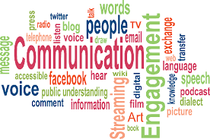

Slide 2
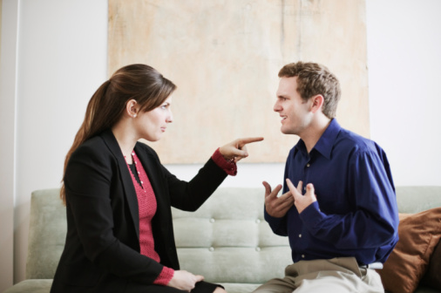
Bell Ringer #1

Slide 3
Who thinks they are good at communicating?
Notes:
PB & J

Slide 4
Communication is...
The exchange of thoughts, feelings, or beliefs between two or more people

Slide 5
There are two main types of communication
verbal
non-verbal

Slide 6
Verbal communication
Using words to communicate
speaking (tone of voice)
letters
text
sign language
(write down 3 in your notes)

Slide 7
Let’s practice our verbal communication!
In your assigned seats, (in pairs or threes) One person will describe the following picture to their partner who is turned around and cannot see.
Do not give the item away. You may only describe the physical details, shapes, sizes etc.
Notes:
Headbandz, charades

Slide 9
Now switch!! Same activity, same rules

Slide 11
Were you a good communicator?
What made this activity easy?
What made it difficult?

Slide 12
Did any of you get frustrated with your partner?
How can we appropriately communicate our emotions?

Slide 13
“I” Statement
Taking responsibility for your feelings.
I feel __________ when ______________.
(emotion) (action/problem)

Slide 14
Examples
“I feel angry when you don’t call and let me know where you are.”
“I feel frustrated when I am interrupted.”
“I feel worried when you come home so late.
Why do we use “I” messages?
We aren’t putting blame on someone for our emotions.
Less likely to put the other person down or make them feel guilty.

Slide 15
Non-verbal Communication
Communicating without words
gestures
facial expressions
body language
emoticons
tone of voice
Write down 2 in your packet

Slide 16
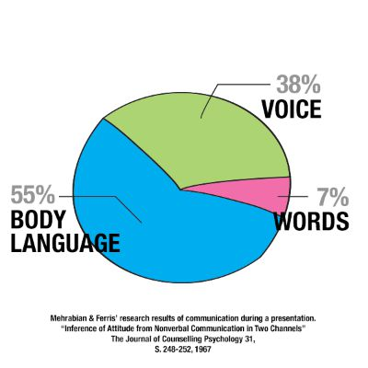
Body Language
The use of visual cues to communicate information or feelings

Slide 17
Activity
Each student will receive a card
keep your card a secret!!
NO TALKING
Assemble in the four groups, (hearts, clubs, diamonds, spades)
Once in your group, line up in rank from Ace to King
Group that lines up first wins!

Slide 18
Mixed message:
When your words say
one thing…..
but your body language or
tone says another!

Slide 19
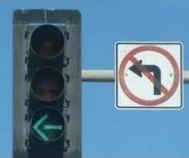
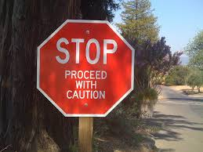
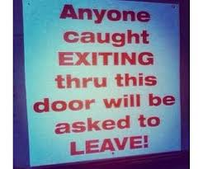
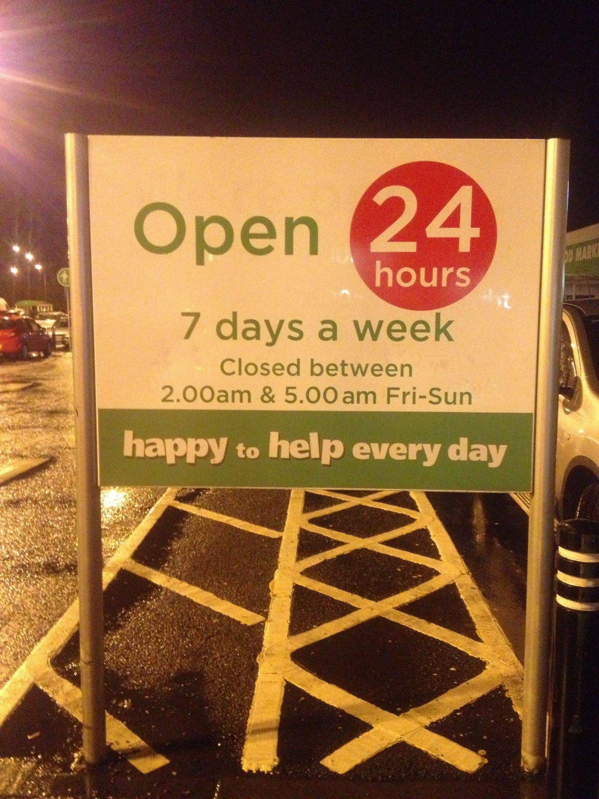
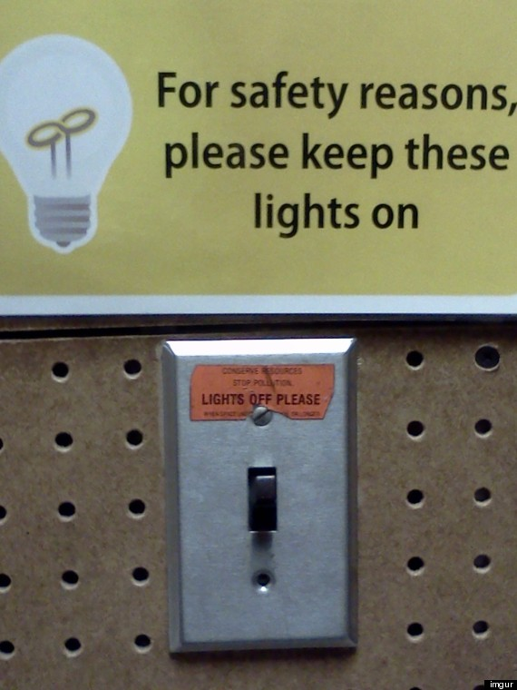
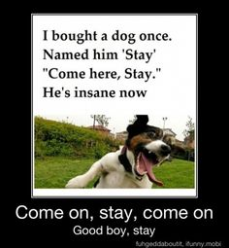

Slide 20
Listen...
I am going to read a list of words.
When I am finished, you will have one minute to write down as many words that you can remember.

Slide 21
Listening
Communication does not just involve speaking!

Slide 22
What does this mean?

Slide 23
It’s not about the nail….

Slide 24
Tips to be an Effective Communicator
Listen
Think before you speak
Concentrate on your body language

Slide 25
Game
Notes:
Telephone, Mad Gab, Speak Out

Slide 26
Exit Ticket
Name:_________ Period:____
Describe non-verbal communication in less than 5 words
List one type of listening and describe it.
on the scratch paper given to you, answer the following questions

