Slide 1
Changes of You
Changes during puberty/adolescence

Slide 2
During Puberty, a lot of changes occur in your body.
But what is puberty?

Slide 3
Puberty
is the name for when your body begins to develop and change.

Slide 4
Adolescence
the teenage years between 13 and 19 and can be considered the transitional stage from childhood to adulthood.

Slide 5
When does puberty occur?
Puberty usually starts some time between age 7 and 13 in girls and 9 and 15 in guys.
Although, some people start puberty a bit earlier and some, later.

Slide 6
What causes puberty to start?
When your body reaches a certain age, your brain releases a special hormone that starts the changes of puberty.

Slide 7
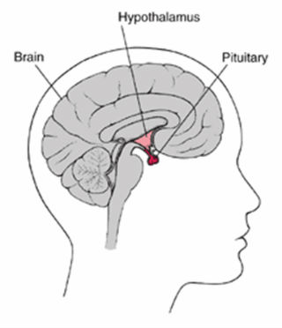
It's called gonadotropin-releasing hormone. When GnRH reaches the pituitary gland (a pea-shaped gland that sits just under the brain), this gland releases into the bloodstream two more puberty hormones: luteinizing hormone (LH for short) and follicle-stimulating hormone (FSH for short). Guys and girls have both of these hormones in their bodies.

Slide 8
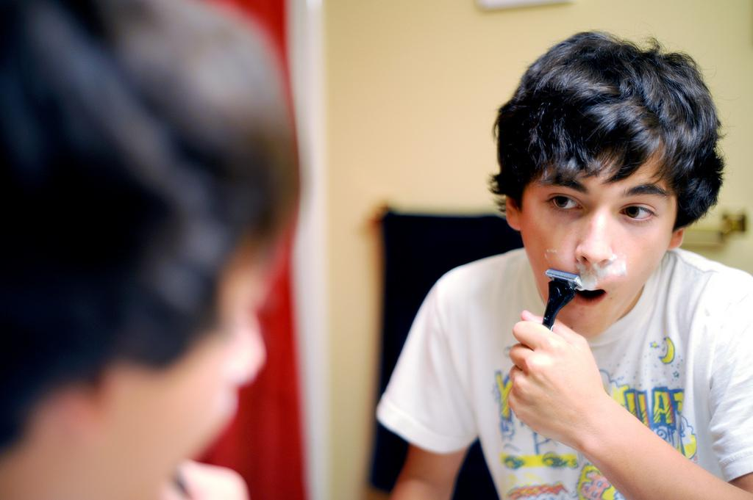
Physical Changes in Boys
Shoulders grow wider
Voices become deeper
Hair growth under the arms and in the pubic areas.
Acne may appear
Odor(caused by a chemical change in the glands)

Slide 9
Physical changes in Girls
Earliest change is usually breast development
Hips get wider
Acne may appear
Hair appears under the arms and in the pubic region
Menstruation (Period) starts

Slide 10
For both boys and girls, it usually takes several years after the first changes of puberty begin before they're all complete — and there's a lot of variation from person to person.
So, two normally developing guys or girls who are the same age can appear quite different from each other.

Slide 11
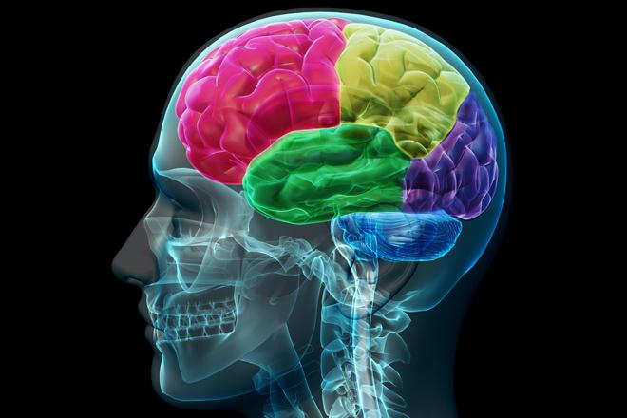
Your brain changes too!
Adolescence is a time of significant growth and development inside the teenage brain.

Slide 12
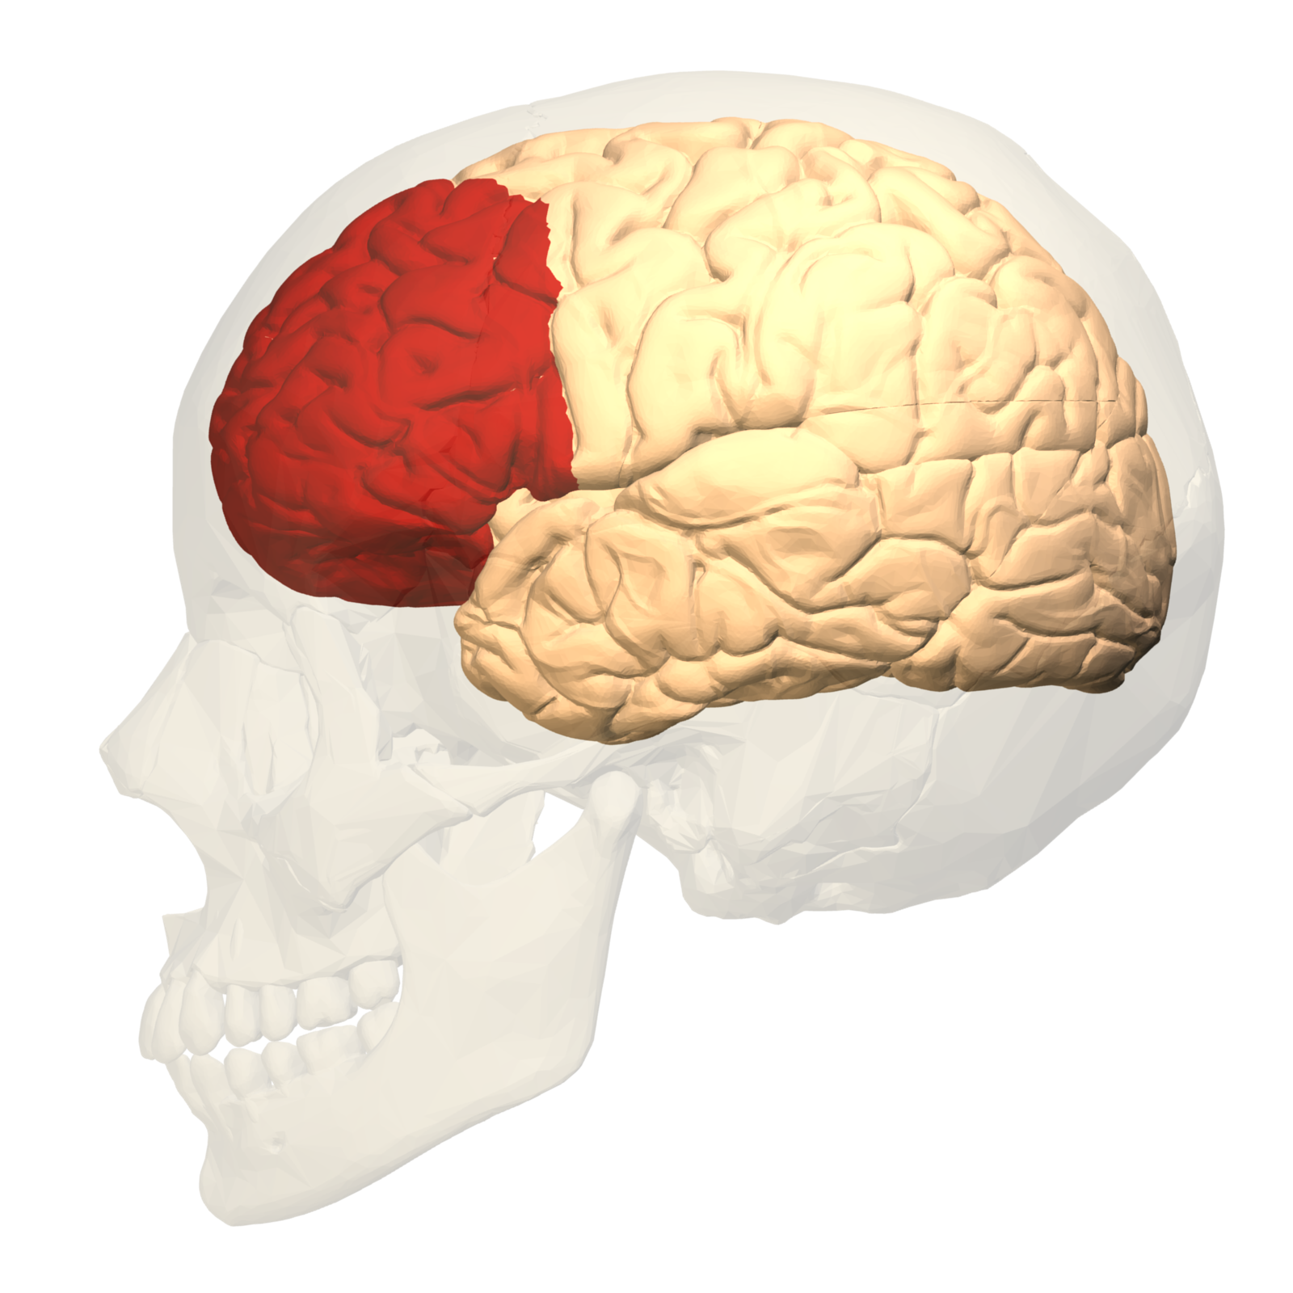
The prefrontal cortex is the decision-making part of the brain, responsible for our ability to plan and think about the consequences of actions, solve problems and control impulses.
Changes in this part continue into early adulthood (finishes around age 25).

Slide 13
Emotional Changes
During puberty, you might feel confused or have strong emotions that you've never experienced before. You may feel anxious about how your changing body looks.

Slide 14
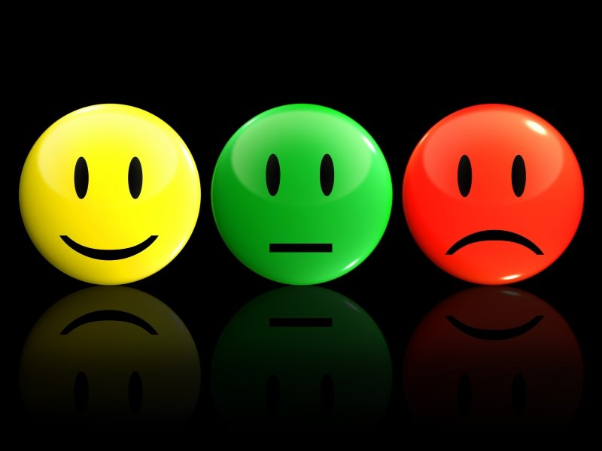
Other Emotional Changes
More romantic interest in others
Learning to control and express your feelings
You start to feel differently about your peers, your parents, and other adults
Feel closer to your friends and feel less connected to your parents.

Slide 15
Handling Emotions
One day you may feel angry, sad, happy, scared, and excited. Next you may feel gloomy enough to cry.
Often caused by hormones
Lashing out at others or keeping feelings hidden inside – not a good way to handle problems
Express your feelings by: writing, draw, play music, exercise, hobbies, talk to friends, siblings, parents, counselors, a trusting adult.

Slide 16
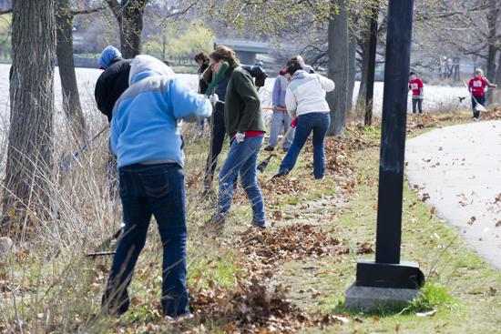
Social Changes
Volunteering in groups, sports teams, or special-interest clubs.
The social connections that you make as a teen can help you develop friendships, find job opportunities, and get emotional support.
These connections also shape your values and help you discover who you are.

Slide 17
Things to Remember...
Does every teen develop at the same time, or even in the same way?
Are you normal if you develop earlier or later than your peers?

