Slide 1
Addiction

Slide 2
KSL Video

Slide 3
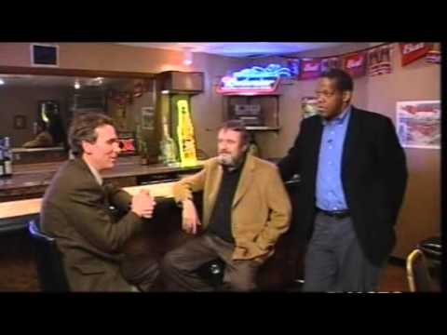
Addiction: Disease or Behavior?
Notes:
Stop at 10:05
Play from 17:45 - 20:00
Play from 23:15 to the end.

Slide 4
What does ADDICTION mean?
It means a person has lost control over whether he or she uses a substance.
They are so used to having the drug that their body needs it to function and they will do just about anything to get it.
IN YOUR OWN WORDS, write down what the word addiction means.

Slide 5
How do you know if someone is addicted?
Substance Abuse: | Addiction:
Using an illegal or legal substance in the wrong way. Can lead to addiction. Ex. John smoked marijuana a few times. It doesn’t mean he’s addicted, but it does mean he’s abusing - and it could lead to an addiction. | Begins as abuse. A person has lost control of their drug use. A person needs the drug in order to function. Can people be addicted to things other than drugs?

Slide 6
How does substance abuse turn into addiction?

Slide 7
Stages of Addiction
First use
Continued use
Tolerance
Dependence
Addiction

Slide 8
Stage 1: First Use
The person tries a drug for the first time.
What might lead a person to try a drug for the first time??
Curiosity, trying to fit in, rebel, depression, etc.
Some people in this stage are able to stop by themselves. Others believe that the drugs are helping their problems or making them feel better so they move into the next stage of addiction.
Ex. Jessica is hanging out with friends. Everyone is smoking pot so she decides to try it.

Slide 9
Stage 2: Continued Use
The person keeps using the drug to feel a certain way.
After the high is over, a person may want to get that feeling again…so they use again.
The person will begin using in a predictable pattern (every weekend) or predictable circumstance (when lonely, bored, or stressed).
Ex. Jessica liked the way that she felt while smoking pot so she does it again. Now she does it almost every weekend.

Slide 10
Stage 3: Tolerance
It takes more of the drug to get high.
Tolerance occurs because over time, the brain adjusts to the drug so it takes more to feel the effects.
Tolerance is a warning sign of addiction.
When a person develops a tolerance, they may need 2 drinks, instead of 1, to get the same effect.
Ex. Jessica has noticed that she has to smoke more in order to get the same feeling.

Slide 11
Stage 4: Dependence
The person gets sick without the drug.
The brain and body gets so used to the drug that they can’t work without it.
The person needs the drug to feel “normal.”
Withdrawal:
When a person stops using the drug, he or she gets sick (headache, diarrhea, insomnia, fatigue, anxiety, nausea).
Withdrawal goes away when the person uses again.
Ex. Jessica hasn’t smoked marijuana for a few days. She feels anxious, depressed, and can’t sleep.

Slide 12
Stage 5: Addiction
The person can’t stop using the drug, even when they know the drug is causing serious problems in all aspects of their life.
He or she will do just about anything to get the drug.
Lie, steal, jeopardize relationships, spend all of their money, etc.
Denial: He or she refuses to admit the drug is the cause of their problems.
Ex. Jessica doesn’t feel like she has a problem. She thinks she can quit whenver she wants to...she just doesn’t want to. She has been stealing money from her mom and dad in order to buy marijuana.

Slide 13
Scenarios
In groups of 5:
You will each be given a different scenario.
Each scenario represents one stage of addiction.
Identify which stage each scenario represents.
HIGHLIGHT or UNDERLINE the things that define the stage you have identified.
**Each group should have scenarios that represent ALL 5 STAGES.**

Slide 14
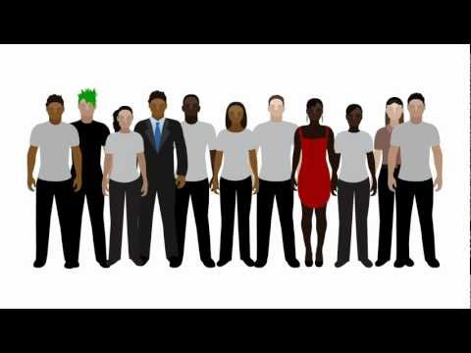
Why do some become addicted and others don’t?

Slide 15
What can you do if someone you know has a drug addiction?
Get educated. You can’t fight an enemy you don’t understand.
Take care of yourself. You can’t control other people, but you can keep yourself healthy.
Talk about it. Build a relationship free of judgement and accusation, but have boundaries.
Don’t expect them to stop without help.

Slide 16
What if you’re the one that’s addicted?
ASK FOR HELP!

