Slide 1
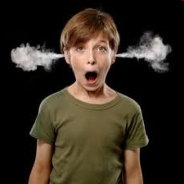
STRESS!!!

Slide 2
What is a stressor?
Anything that causes you stress…like the things you listed in your bell ringer.
Top 4 Teen Stressors
School
Friends
Family
Appearance
Notes:
‹#›

Slide 3
What is Stress?
The body’s response to a demand or pressure.

Slide 4
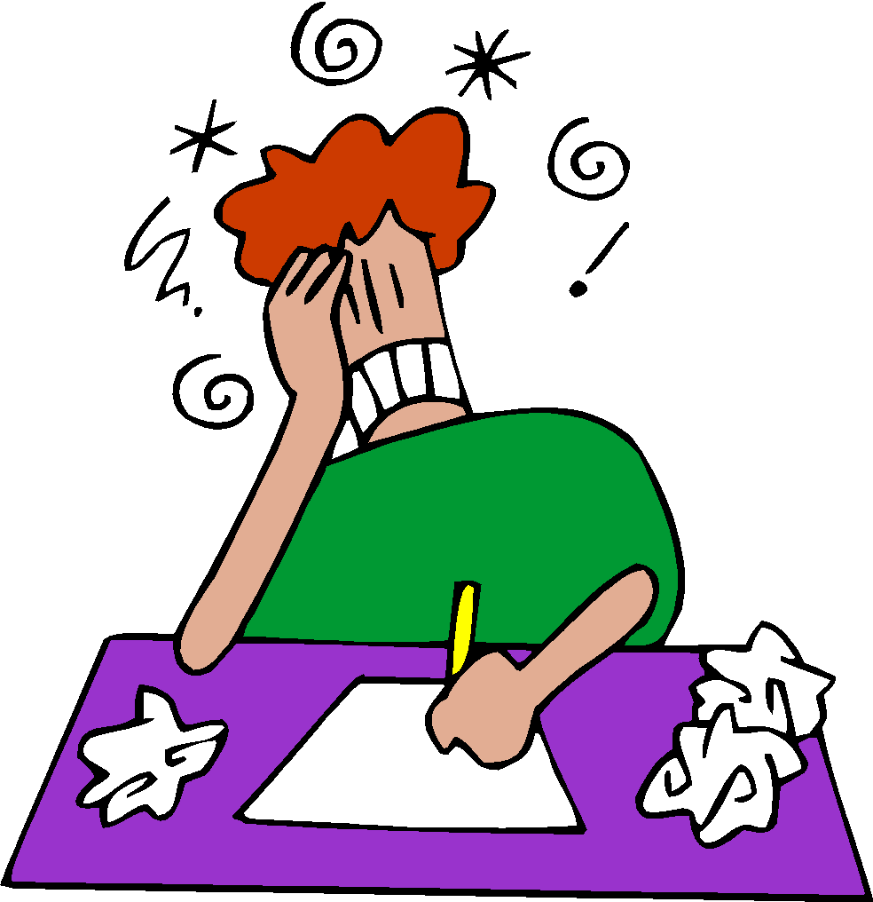
Distress: negative stress
Distress can cause these symptoms:
Feeling worried and uptight
Discomfort and Illness
Lower Performance Level
Fatigue
High Blood Pressure

Slide 5
Eustress: positive stress
Eustress can cause these symptoms:
Good feelings
Motivation
Higher Achievement
Notes:
‹#›

Slide 6
1 to 100
Each group member get out a blank sheet of paper. Each group needs ONE PEN.
When I say, “go,” the first person rolls the dice one time, trying to get doubles. If they don’t, it is the next person’s turn.
When doubles are rolled, that person grabs the pen and starts writing the numbers 1, 2, 3, 4, 5, 6, etc…all the way to 100.
THE CATCH: While the person is writing, the dice is continuing around the circle. As soon as another person rolls doubles, they “steal” the pen from the person writing and start writing their own list of numbers, starting with 1.
The dice is always being passed, the pen being “stolen” whenever someone rolls doubles.
The first person to be able to write all the numbers, 1 to 100 wins!
REMEMBER: After the pen is stolen from you, and then you roll doubles again and get the pen back, you pick up with the number you left off on. You don’t start back with 1.
Notes:
Stop at about 1:45
‹#›

Slide 7
How did you think, feel, or act during that game?

Slide 8
Stress Response

Slide 10
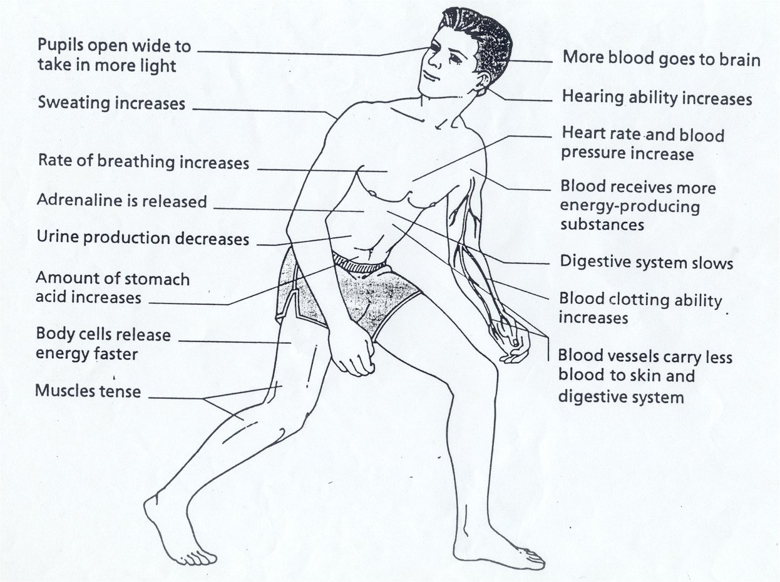
Fight or Flight

Slide 11
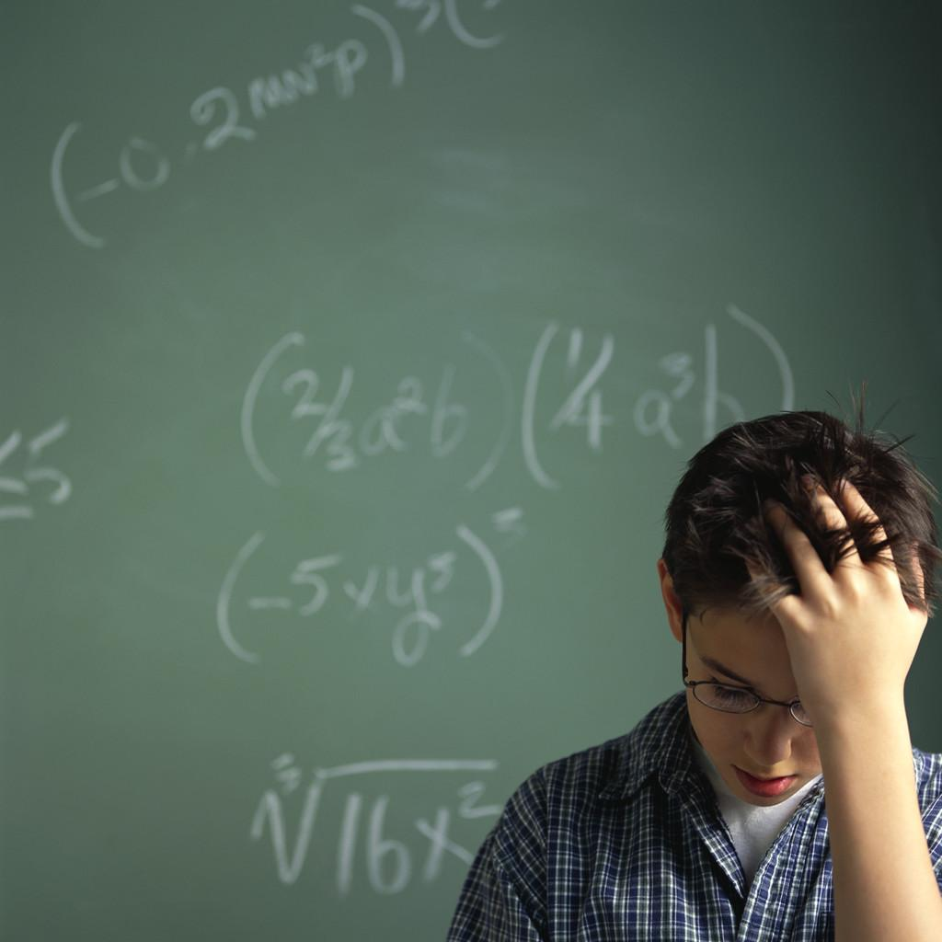
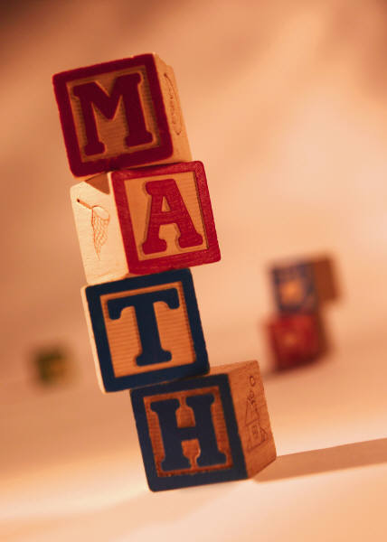
Distress, eustress, no stress
Going to math class

Slide 12
Distress, eustress, no stress
Taking a roller coaster ride

Slide 13
Distress, eustress, no stress
Watching a scary movie
BOO
BOO
BOO

Slide 14
Distress, eustress, no stress
Holding a snake

Slide 15
Distress, eustress, no stress
Getting your report card

Slide 16
Distress, eustress, no stress
Going to a dance

Slide 17
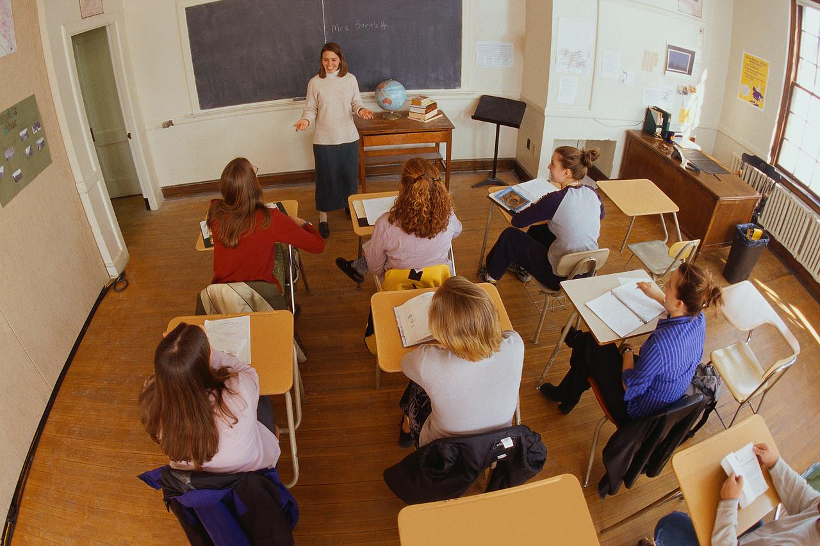
Distress, eustress, no stress
Giving a speech to the class

Slide 18
Tennis ball toss
a. How did the catcher do when the tennis balls came at him/her slowly, one at a time?
b. How did the catcher do when the tennis balls came at him/her faster, one at a time?
c. How did the catcher do when the tennis balls were all tossed to him/her one at a time?
d. What can this activity tell us about stress in our lives?
Can stress be a good thing?

Slide 19
Life = Stress
Tom is studying for an important history test
Kerrie is warming up for the big game tonight
Cindy recently moved to a new school
Jon is checking in the mirror one more time before he picks up Stephanie for their first date

Slide 20
The Solution
STRESS MANAGEMENT!!
Identify the stressor…”Why am I stressed?”
Learn how to manage the stressor in a healthy way.

Slide 21
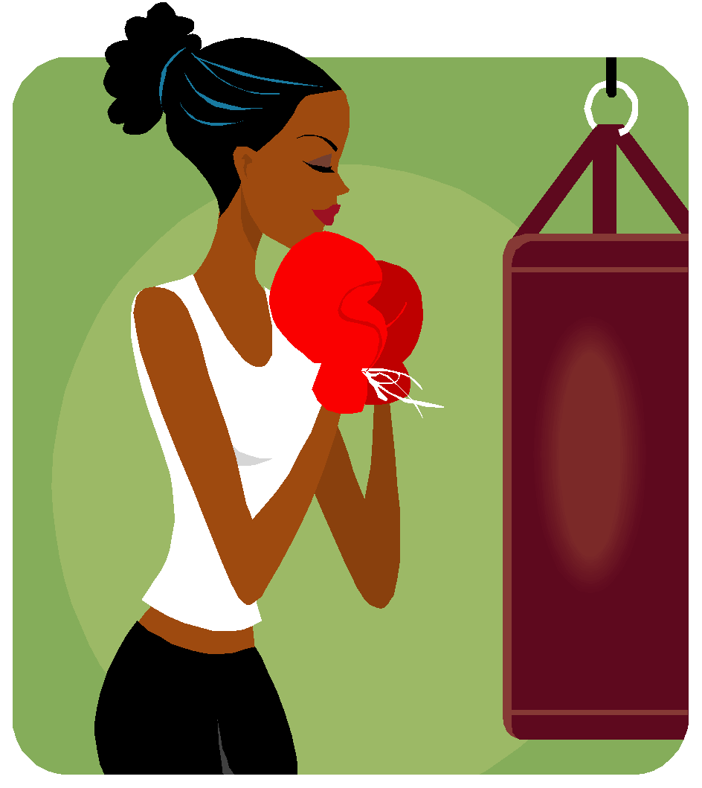
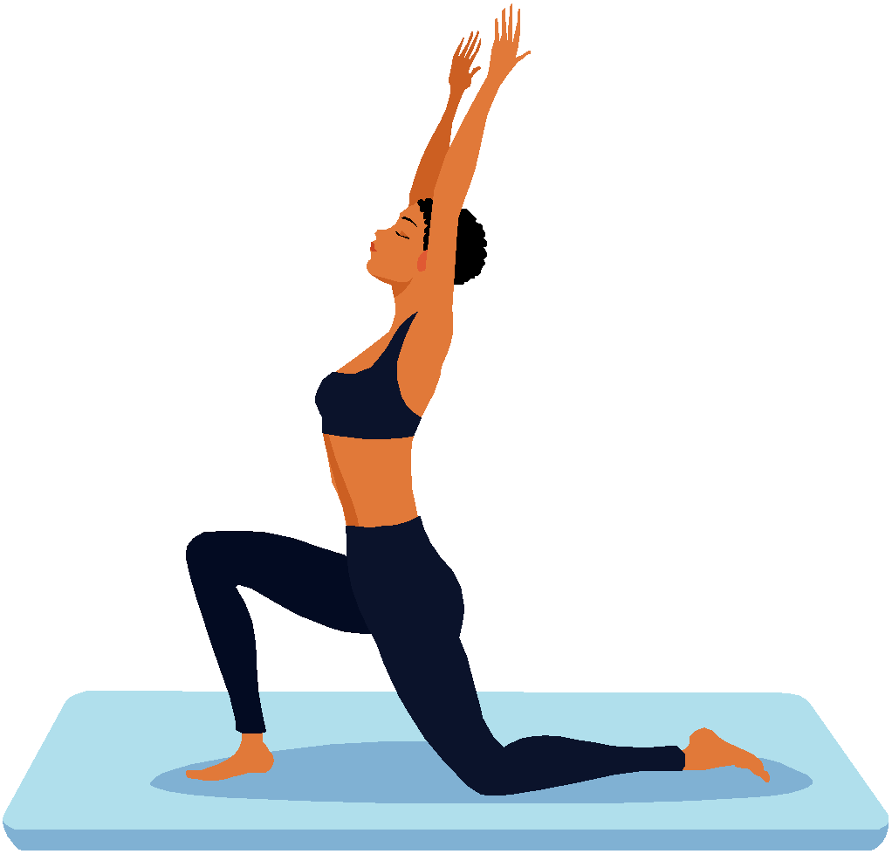
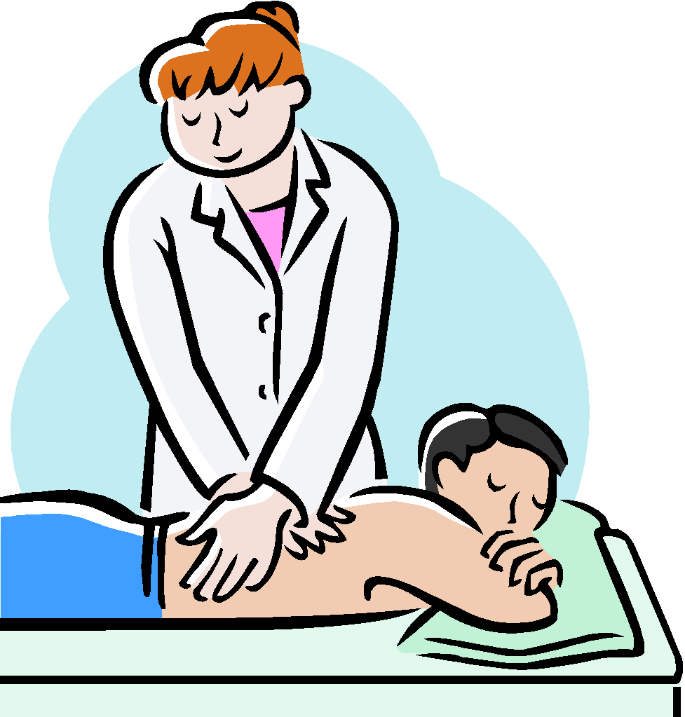
Body Stress Tips (Write down 3)
Deep Breathing
Progressive Muscle Relaxation
Physical Activities
Stretching
Yoga
A Massage
Soaking in a hot tub

Slide 22
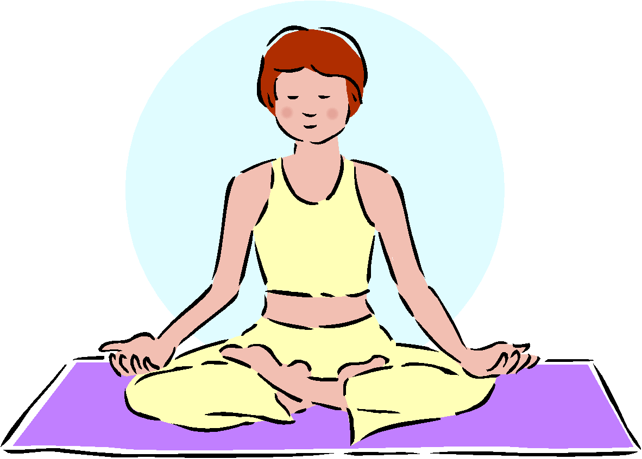
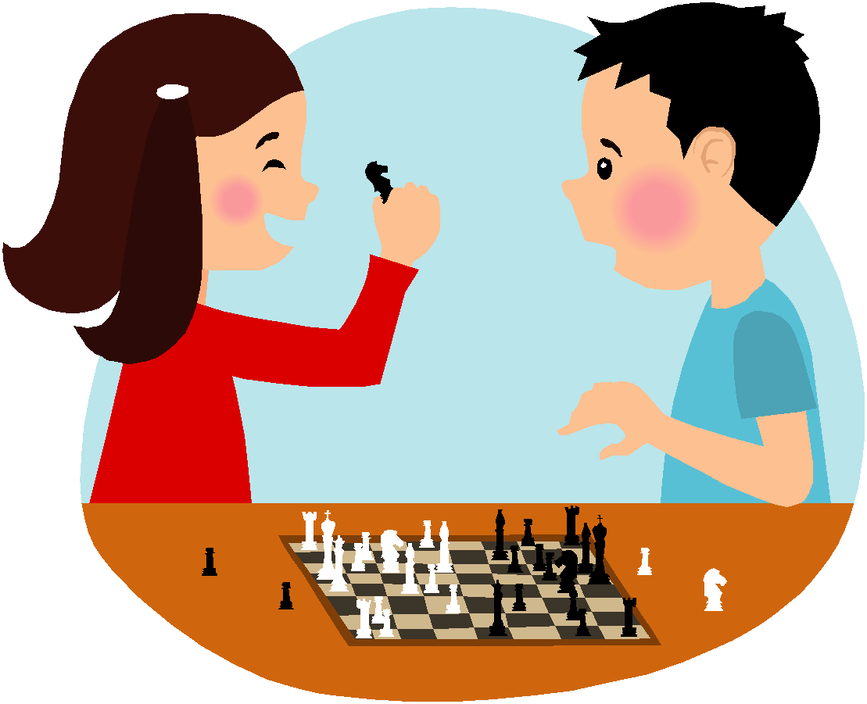
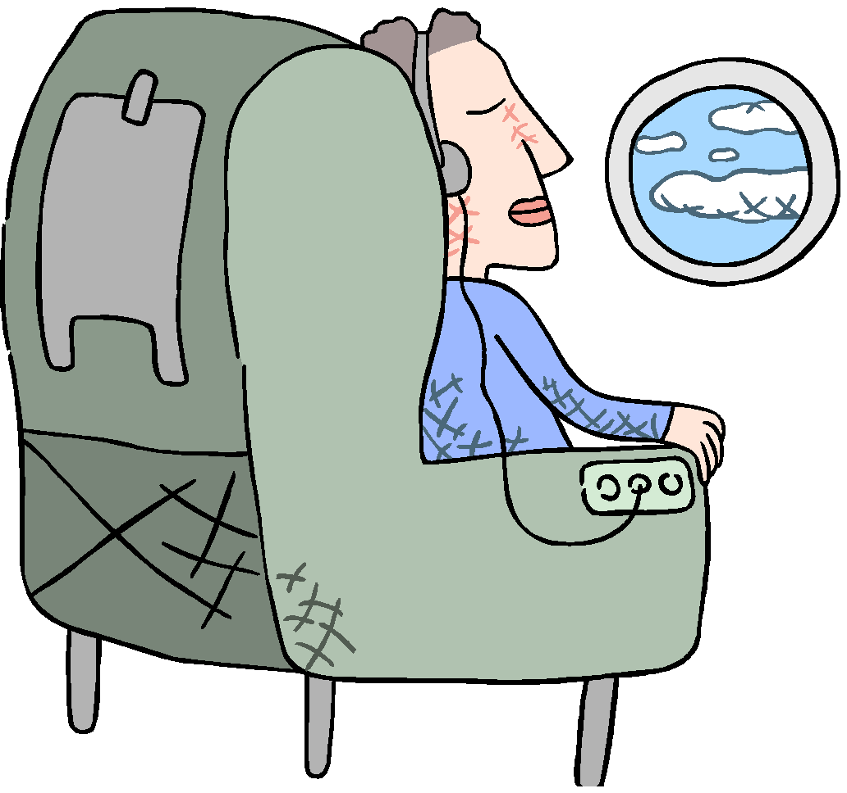
Mind Stress Tips (Write down 3)
Meditation
Reading
Visualization
Listening to calming music
Movies
Games
Puzzles
Hobbies and crafts

Slide 23
Go back to your list of stressors from your bell ringer...
On the lines below or on a scratch piece of paper, identify the things you do in order to deal with those stressors.
Next time, we will practice stress management!

Slide 24
Assignment
Read the article
When finished, come grab an assignment.

