Slide 1
SUICIDE PREVENTION

Slide 2
THE LINK BETWEEN DEPRESSION AND SUICIDE
Sometimes depression can lead to suicidal thoughts…why?
Notes:
Blue october into the ocean

Slide 3
THE LINK BETWEEN DEPRESSION AND SUICIDE
Sometimes depression can lead to suicidal thoughts…why?
Depression overwhelms the mind and body.
The person wants to find a way to end the pain.
Suicidal thoughts can begin.
A person suffering from depression has a difficult time thinking clearly and rationally. This is why it is so important for those suffering from depression to get the help they need.

Slide 4
Statistics
Utah statistics:
About 500 Utahns die from suicide each year.
Almost 4,000 Utahns attempt suicide each year.
Every day in Utah,
Two youth (ages 10-17) are treated for suicide attempts.
Two young adults (ages 18-24) are treated for suicide attempts.
Suicide is now the leading cause of death among youth ages 10-19 in Utah.

Slide 5
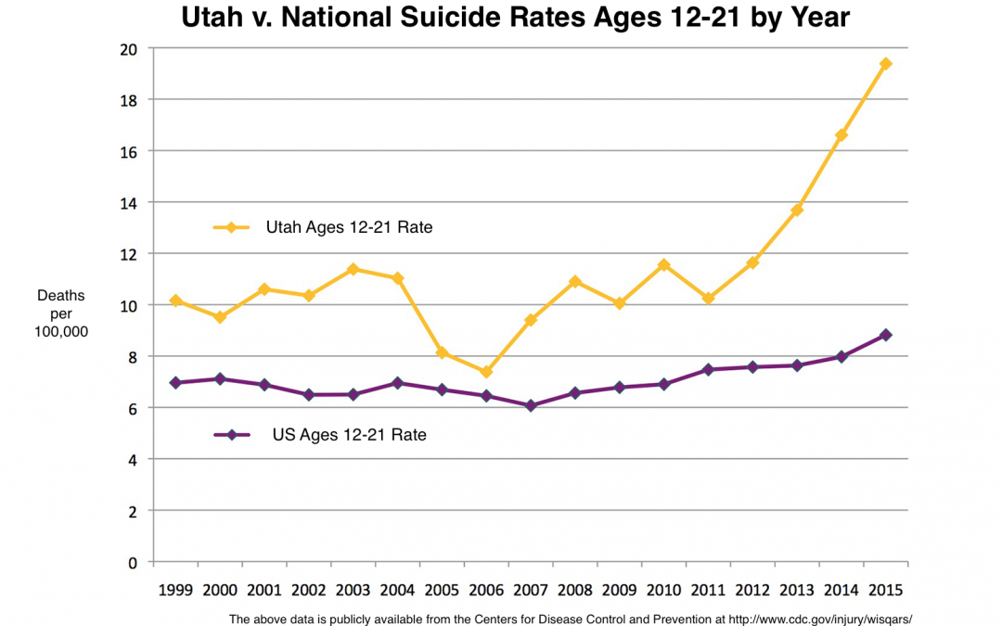

Slide 6
TRUE OR FALSE?
Teens who talk about suicide are doing it for attention.

Slide 7
TRUE
They NEED attention. They are reaching out for help. They need to people to listen to them and to help them.

Slide 8
TRUE OR FALSE?
Most people who are suicidal are depressed.

Slide 9
TRUE
The reverse of this statement is not true. It doesn’t mean that most depressed people will attempt suicide. Many people with depression will have no thoughts of suicide.

Slide 10
TRUE OR FALSE?
Suicidal people want to die, therefore, there is no way of stopping them.

Slide 11
FALSE
Suicidal people do not necessarily want to die, they just want their pain to go away. They are struggling to find a solution and therefore need our help.

Slide 12
TRUE OR FALSE?
Talking about suicide will cause someone to attempt suicide.

Slide 13
FALSE
Not talking about it could make it worse. It will help those contemplating to realize that there is support and help for them, and hopefully encourage them to seek help. It will also help those who suspect someone is contemplating suicide to know that it is okay to be open, ask question, and get others help.

Slide 14
TRUE OR FALSE?
Once a person is suicidal, they are always suicidal.

Slide 15
FALSE
Suicidal feelings are usually temporary. A person who has received help for suicidal thoughts or behavior can live very productive lives.

Slide 16
WHY DON’T PEOPLE TALK ABOUT MENTAL ILLNESS OR SUICIDE?
How many of you have broken a bone? What did you do about it?
Why don’t we do the same thing for depression, suicidal thoughts, etc? Isn’t your mental health just as important as your physical health?
STIGMA: Something that has a negative association attached to it.

Slide 17
WARNING SIGNS of SUICIDE
Sudden or extreme changes in mood or personality
Prolonged depression
Consistent low energy level
Avoidance of activities with friends or family
Taking greater risks than usual
Substance abuse
Giving away prized possessions
Talking about death or making suicide attempts
Making suicide threats

Slide 18
WHAT CAN YOU DO IF YOU SUSPECT A PERSON IS SUICIDAL?
QPR
QPR can be compared to CPR.
It can be used as a life saving technique.
Both are used once a need is detected.

Slide 19
Q: QUESTION
Question the person to determine if he or she is contemplating suicide.
(Write down an example from below)
Are you serious about what you said?
Are you thinking about suicide?
What do you mean by what you just said?

Slide 20
P: PERSUADE
Persuade the person to get help.
(Write down an example from below)
Let me help you.
Let’s go get some help.
Come with me to talk to a counselor.

Slide 21
R: REFER
Refer the person to someone who can help.
(Write down an example from below)
It’s best to actually take the person to get help.
Have the person agree to see a professional and follow up with them to make sure they go.
If the person doesn’t seek help, notify someone who can help them.

Slide 22
WHERE TO GO FOR HELP
Parents
Teachers/Counselors
If there is an immediate danger, call 911. If at all possible, do not leave the person alone.
Utah County Crisis Hotline 801-226-4433
WHATEVER YOU DO, DO NOT KEEP IT A SECRET.

Slide 23
Popsicle Stick Activity

Slide 24
Letter to a friend

